Slide 1



AQA Lit B – “Encouraging wider reading, both inside and outside the classroom”
Craig Batty
Curriculum Leader (English)
Sandbach High School and Sixth Form College
Craig_Batty
Notes:
Main focus – academic reading…

Slide 2
AQA Lit B – “Encouraging wider reading, both inside and outside the classroom”
Why did we look at this?
Disappointing set of results – at odds with excellent GCSE results
Question-level analysis and requested papers: students struggled to engage with AO4 and AO5
Cohort of students:
Voracious readers; passionate about literature
Did well at GCSE, generally positive attitudes about reading
GCSE Literature a strength, no embedded culture of reading (only set texts)
Most fell into these two categories…
Notes:
Animate final 3 points

Slide 3
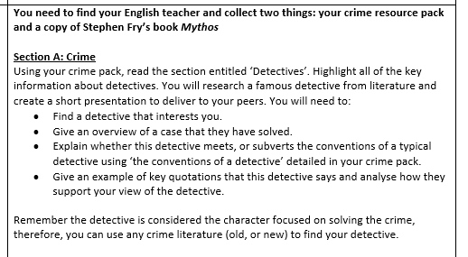


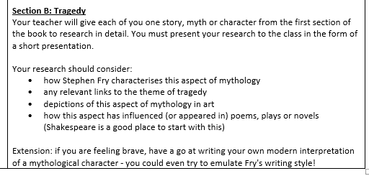
Induction project

Slide 4
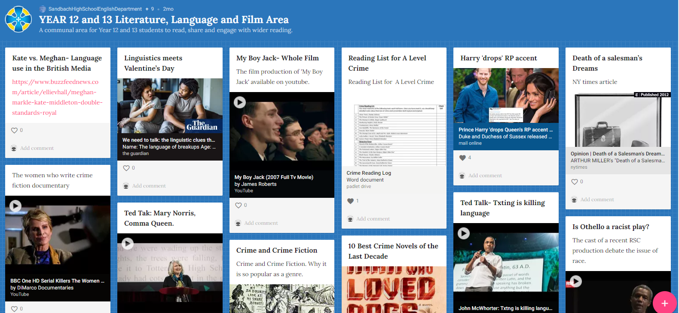
Padlet: https://padlet.com/sandbachhighschoolenglishdepartment/1w1p130fc48fbd17

Slide 5
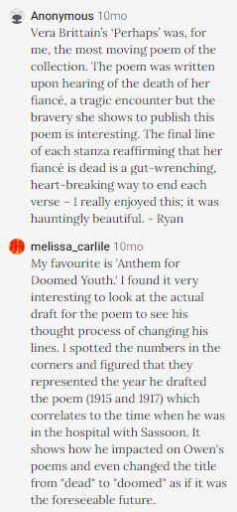
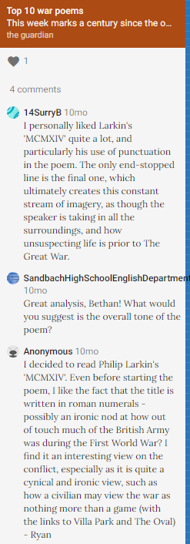
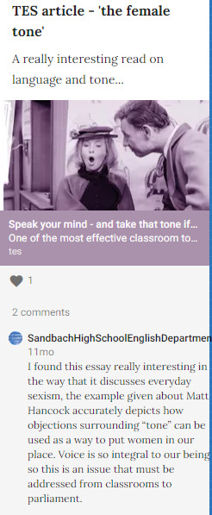

Slide 6
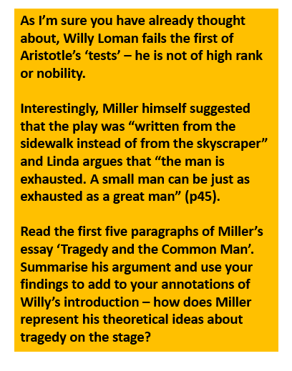
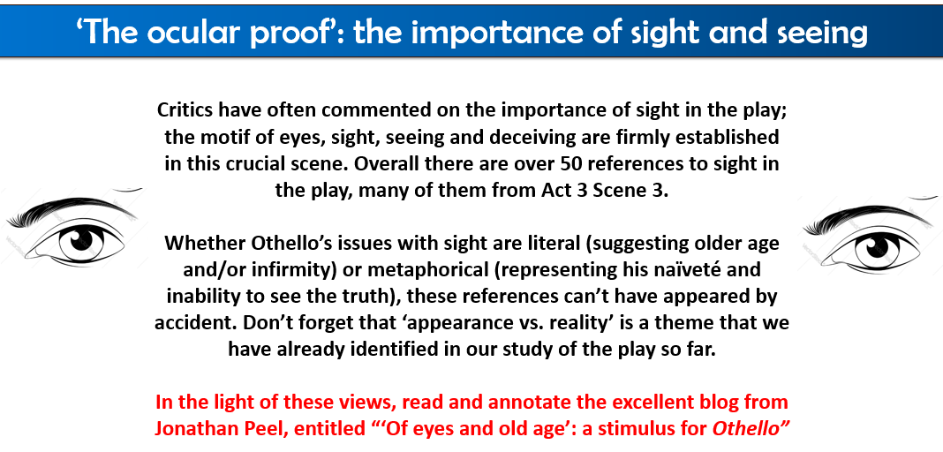
Making reading part of the lesson

Slide 7

‘Who is right, and why?’

Slide 8


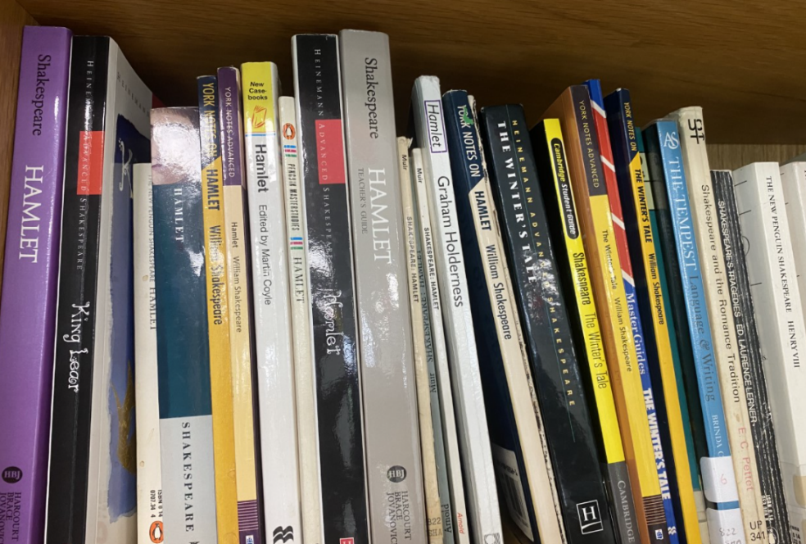
Increasing independence; preparing for university…

Slide 9
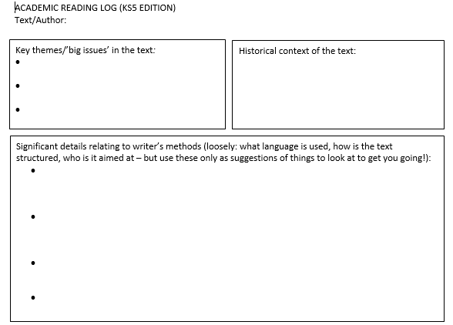
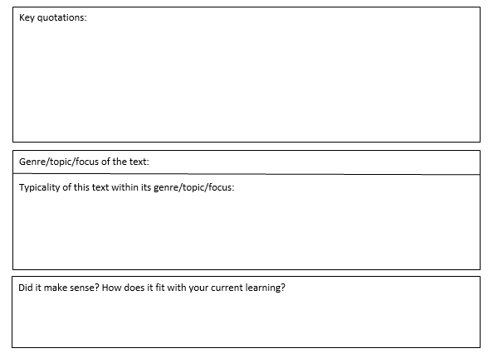
Increasing independence; preparing for university…
Notes:
Completed example – Ryan?

Slide 10
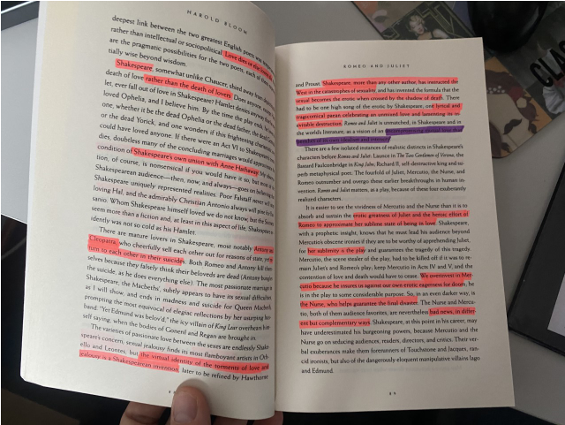

Passing on a culture of reading, from student to student…

Slide 11
Thank you for listening!
Craig Batty
Curriculum Leader (English)
Sandbach High School and Sixth Form College
Craig_Batty
Notes:
Main focus – academic reading…

