Slide 1
Scaffolding Discussion for A Level English Literature
Dr Amy Smith
@amy_smith117
#WeekendLitChat

Slide 2
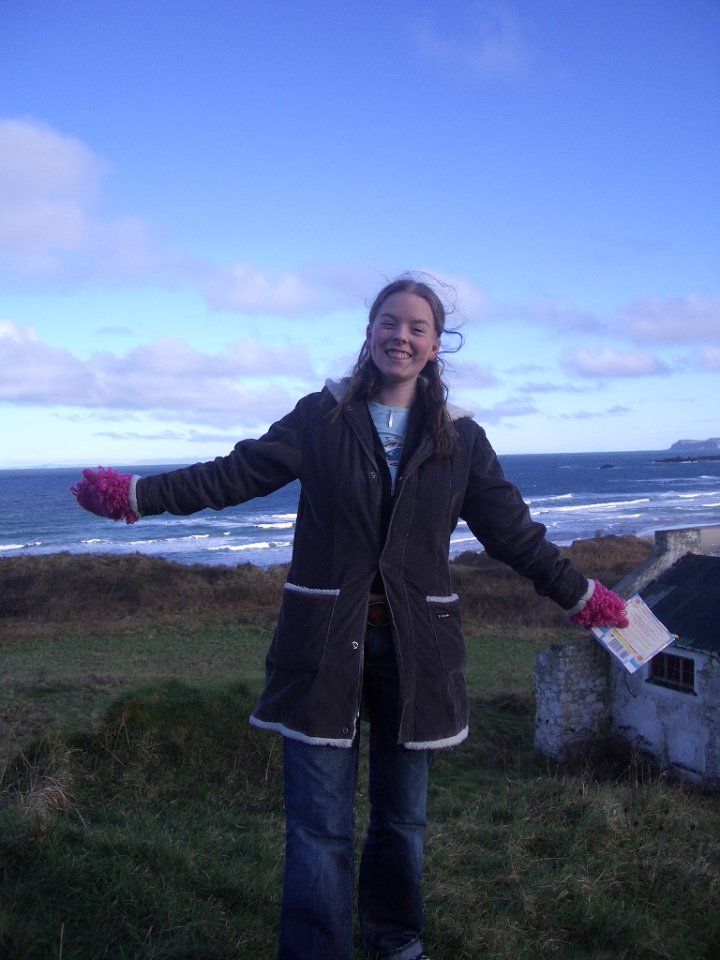
The “anyone, anyone” lesson

Slide 3
What would I tell my 2005 self?
Discussion is important because it helps the teacher to…
Develop ideas by bringing a wider range of possibilities to the table to expand understanding;
Check students’ understanding;
Give students an opportunity to practice articulating their ideas – “reading and writing float on a sea of talk” (James Britton);
Preparation for university interviews and seminars: cultural capital.

Slide 4
Creating the conditions for discussion
“An environment is psychologically safe when people feel they can offer suggestions and take sensible risks without provoking retaliation or ridicule.”
(Mary Myatt – Back on Track)

Slide 5
Creating the conditions for discussion
“Make it easy for them to participate in discussion and hard for them not to.”
(Tom Bennett – Running the Room)

Slide 6
Creating the conditions for discussion
Ensure excellent subject knowledge
Clearly communicate high expectations
Develop a sense of trust and belonging

Slide 7
Creating the conditions for discussion
Preparation: your subject knowledge
Careful pre-reading and annotation of your copy of the text is key;
Take opportunities for online CPD (MASSOLIT/ twitter/ LitDrive);
Find opportunities for pre-discussion within your department or online (for example, send me a question for #WeekendLitChat).

Slide 8
Creating the conditions for discussion
Preparation: the students’ subject knowledge
Students will feel more confident engaging in discussion if their knowledge base is secure.
  Knowledge organisers – distil the core knowledge prior to teaching;
  Regular, predictable, spaced knowledge retrieval;
  If possible, look at GCSE work or speak to their GCSE teachers;
  Regular checking of students’ understanding;
  Effective homework setting (e.g. Cornell note-taking for MASSOLIT/youtube lectures; pre-reading; consolidation tasks; MCQs).

Slide 9
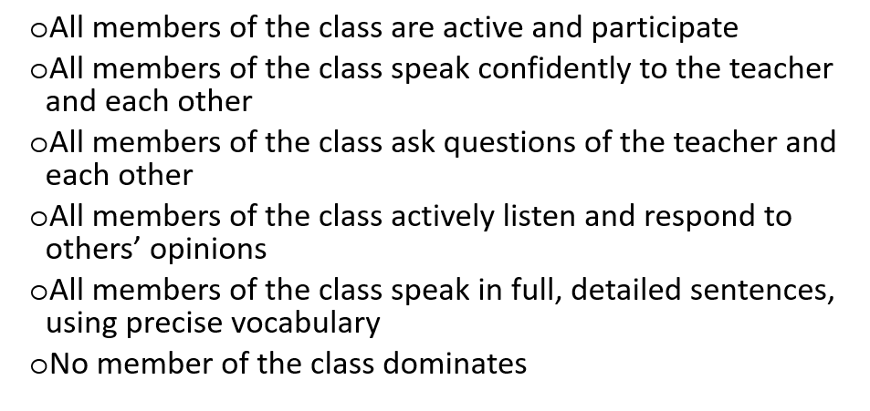
Creating the conditions for discussion
Clearly communicate high expectations

Slide 10
Creating the conditions for discussion
Develop trust and belonging
Value all voices equally and listen carefully;
Make discussion low stakes – regular and with predictable expectations;
3 point discussion (as recommended for instructional coaching in WalkThrus);
Scaffold high expectations.

Slide 11
The discussion itself
Questioning strategies
Balance of cold-calling and students indicating they wish to enter the discussion (e.g. hand up).
ABC questioning:
  Agree – do you agree/disagree with X’s idea? Why? Where is your evidence for that? Does that link to Y’s thoughts about…?
  Build – what can you add to Z’s thinking there? What evidence might Z be able to use to support their argument? What might Z have forgotten? Could Z link this idea to another character in the text?
  Challenge – what about the counter-argument that…? Have you considered…? How do X’s ideas counter what you are saying?
Pre-release questions.
Show genuine curiosity – there doesn’t have to be a pre-determined destination or answer.

Slide 12
The discussion itself
Think – Pair – Share
Your ideas | Your partner’s ideas | The class’s ideas

Slide 13
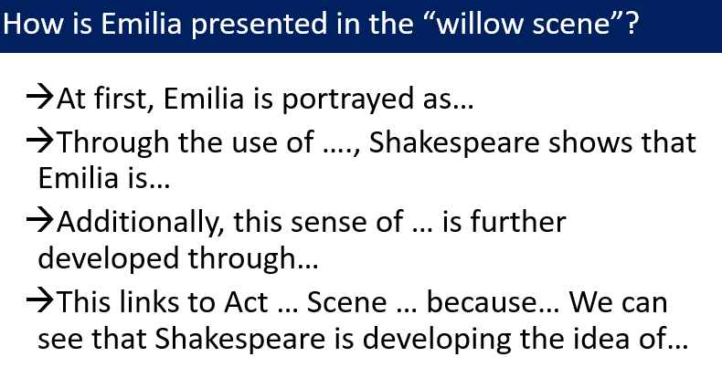
The discussion itself
Think – Pair – Share
And/or
Word bank
Quotations list

Slide 14
The discussion itself
Think – Pair – Share
What did you and your partner discuss?
  A low stakes question – the student does not have to aim for a “correct” answer.
  Leaves the discussion open for divergent ideas.
Give me one sentence to summarise your discussion with your partner.
  Low stakes, limited, clear expectations.
  Credit to Stacey Reay.

Slide 15
The discussion itself
Rehearsal and repetition – say it again better
How could you include this word in your response?;
Sam, can you summarise Siobhan’s argument for us?;
Good ideas – and they were a bit fragmented. Can you put it together in 2 sentences?;
That’s a really important concept to be able to explain – everyone, take 60 seconds to explain X to your partner. [Then randomly sample the class and repeat until they are all fluent.]

Slide 16
The discussion itself
Coping with mistakes
Normalise mistakes – we all make them and they are an opportunity for learning;
Model how to approach a lack of knowledge or understanding [I’m not sure what Coleridge said about Iago – I’m just going to check my notes…];
Give time to refer to knowledge organisers / notes;
Quick think – pair – share;
Strip it back to concrete knowledge and bring the whole class in – then build up incrementally [Ok, let’s take a step back Zeyna. Lewis – can you remind us what Othello says to Desdemona when he arrives at Cyprus? And what does that mean Ben? So what can we learn about their relationship at this point in the play Lydia?].

