Slide 1

Positive or negative?
Read through the sentences and discuss with the person next to you which word is needed for each.
tolerable |  | His decision to leave his washing just outside the washing machine was…
intolerable
compassionate |  | Her friend cried when she tripped over, but she laughed which was clearly …
uncompassionate
objective |  | When deciding, the company looked for an external view which was…
unobjective

Slide 2
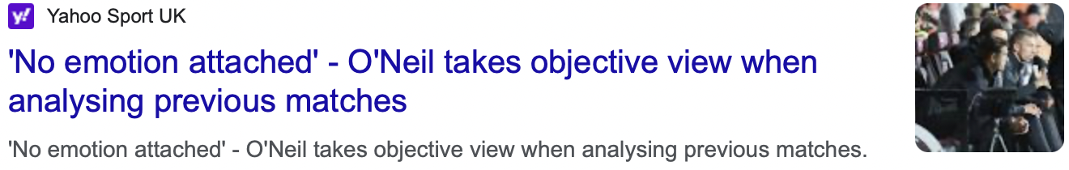
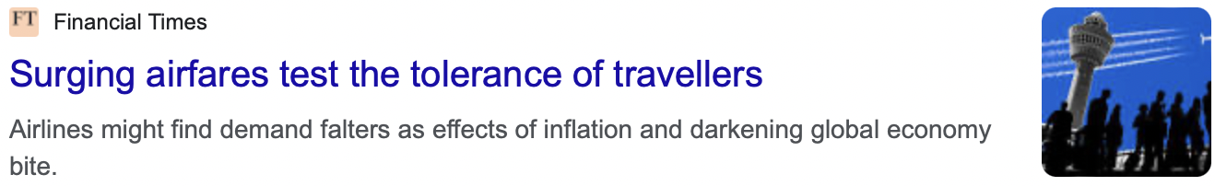
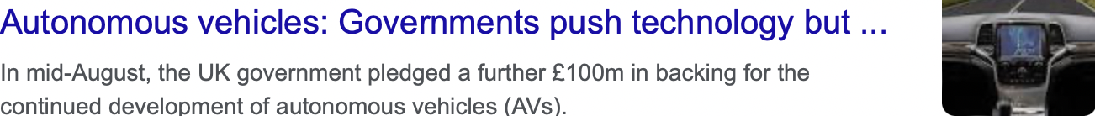
What’s the news?
Read through the following headlines which include this term’s vocabulary. Discuss with the person next to you what the article might be about.
Objective
tolerance
autonomous

Slide 3

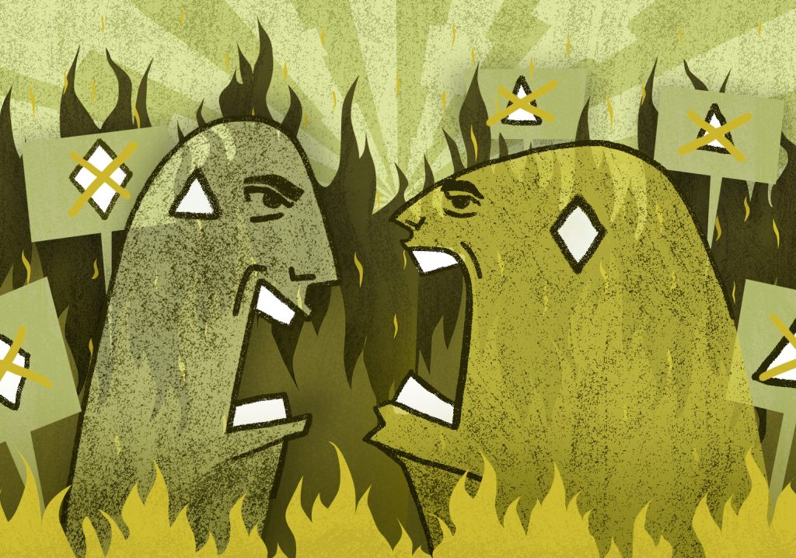
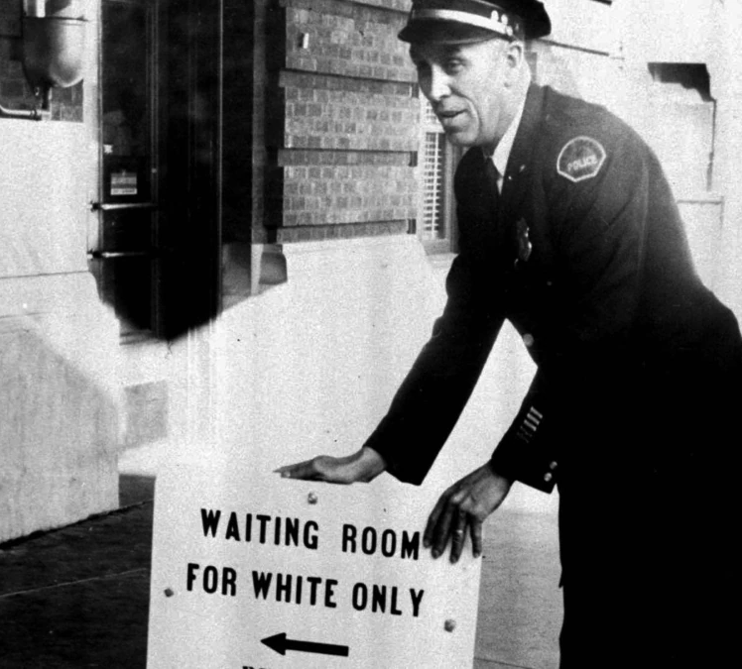
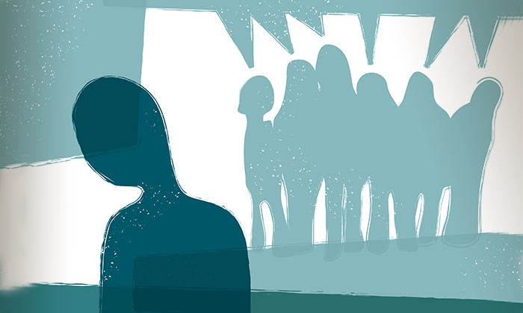
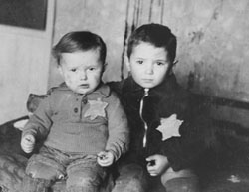
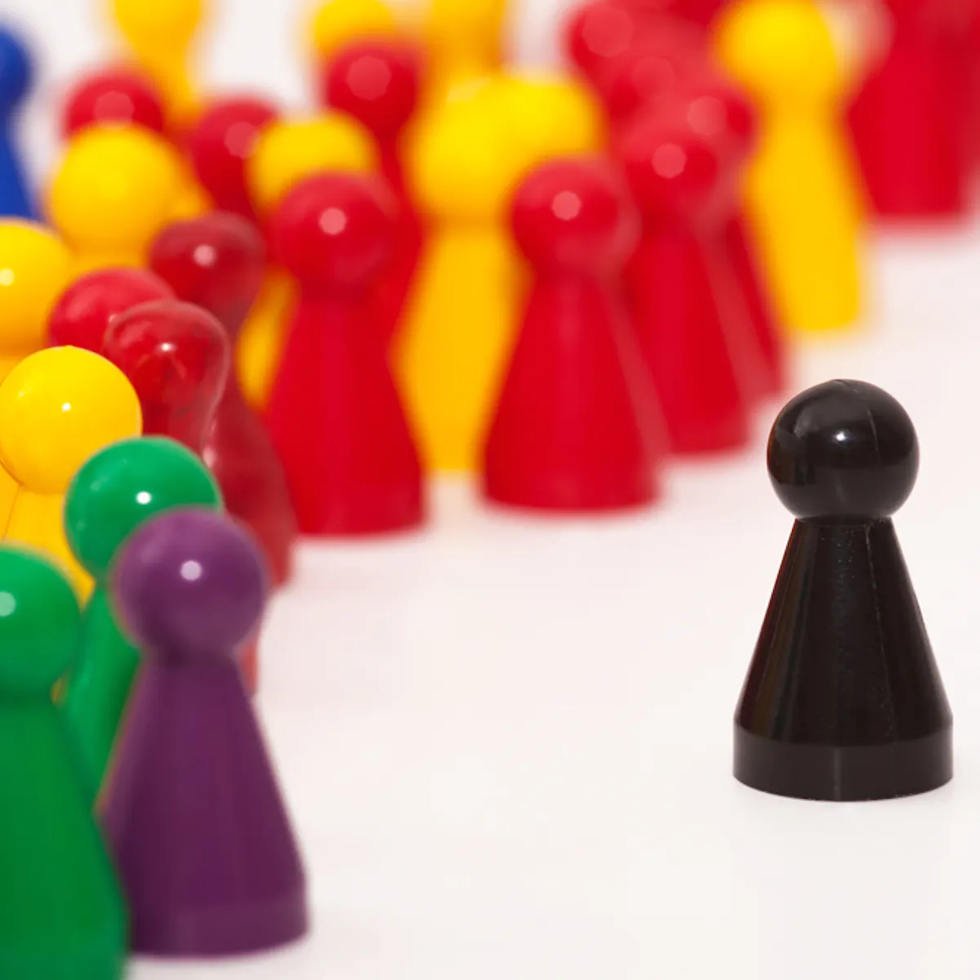
How does this link?
You have a range of pictures below. Discuss which picture you would match to each word, and why.
radicalisation
prejudice
marginalisation
segregation

Slide 4
How many words?
You have been given the roots of two key words. Working in pairs, write down as many words as you can which include the same morpheme.
a u t o n o m y
auto : self, one’s own
nom (num/nem): manage, take
Take take control of the self or to self-manage
p r e j u d i c e
pre (pro): before
judge (jud/jus/jur): examine, diagnose, to form an opinion
To form an opinion before/ too soon

Slide 5
How many words?
auto | nom num nem | pre | judge jud jus jur
autograph automatic autobiography automotive autopilot autocrat autocracy | economy astronomer gastronomy taxonomy nomadic antinomy nemesis numerator | Premature Apprehend preamble Pre-arrange Precaution Precede Preconception premonition | Judgement Judicate Misjudge prejudge Judication Judicious Just Jury
self | manage | before | examine

Slide 6
Can you sort the word?
Below you have 5 actions. Discuss which are good examples of the key word, and which are not.
You help an old person carry their shopping to the car.
You see a footballer coming towards a door. You hold the door open for them.
You are running a race and someone falls over. Others carry on running. You pause and help them up, then carry on.
You have a friend who enjoys gaming. You let them borrow your game and you borrow one of theirs.
You buy a tea for a homeless person who looks cold.
compassion

Slide 7
Can you sort the word?
Below you have 5 actions. Discuss which are good examples of the key word, and which are not.
You have twelve sweets and two friends. You each eat four sweets.
A woman loses a promotion when she tells her employer she’s pregnant.
You have twelve sweets and two friends. You had sweets earlier, so you take two. One friend is hungry, so you give them six. The other friend is given four.
A company has 9 white managers, and they have a job open. They only invite to interview black, Asian and minority ethnic (BAME) candidates who have applied.
Using a jury in a criminal trial
equity

