Slide 1









KIP Quiz - Mixed Literature Questions
 | Question | Text
1 | Give a quotation from ‘Exposure’ | Poetry
2 | Give any quotation from act 2 | An Inspector Calls
3 | Who kills Macbeth at the end of the play? | Macbeth
4 | GOCPresent has a “______ torch” and an “______ hand” and is a “_______ giant” | A Christmas Carol
5 | What meat do the Cratchits eat in stave 3? | A Christmas Carol

Slide 2

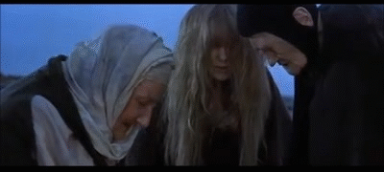
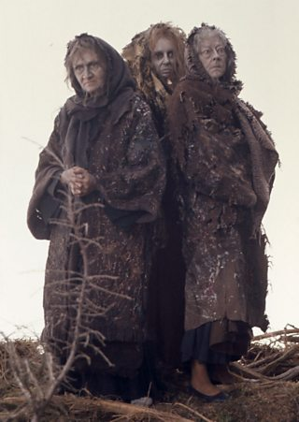
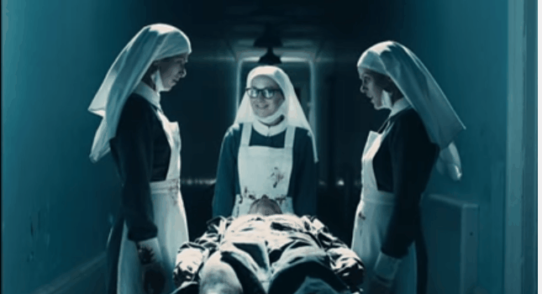
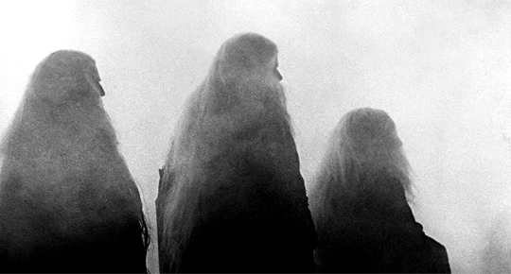
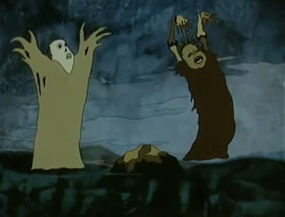
Turn and talk: what is the function of the witches?
Why do you think Shakespeare starts the play with them?
what is the purpose of the ghost of christmas yet to come

Slide 3
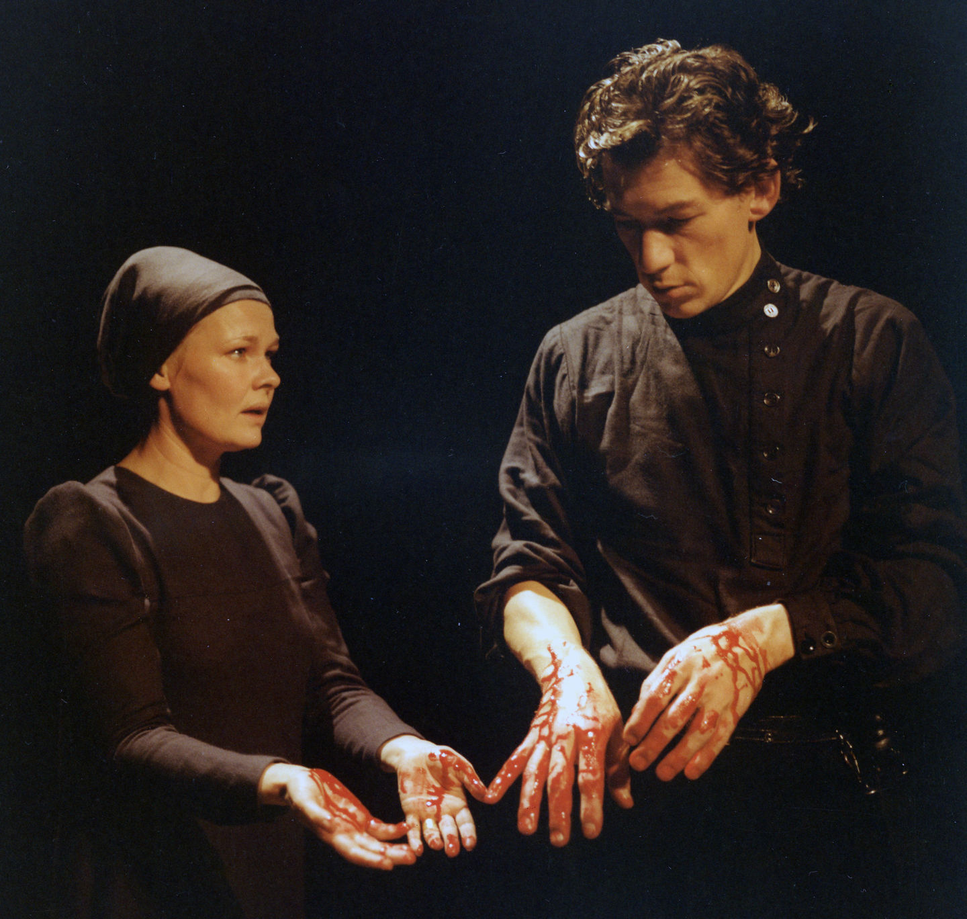
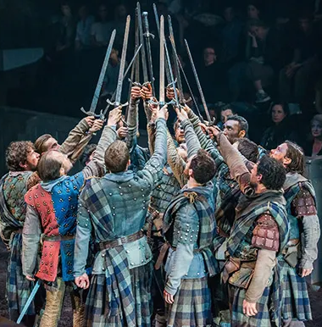
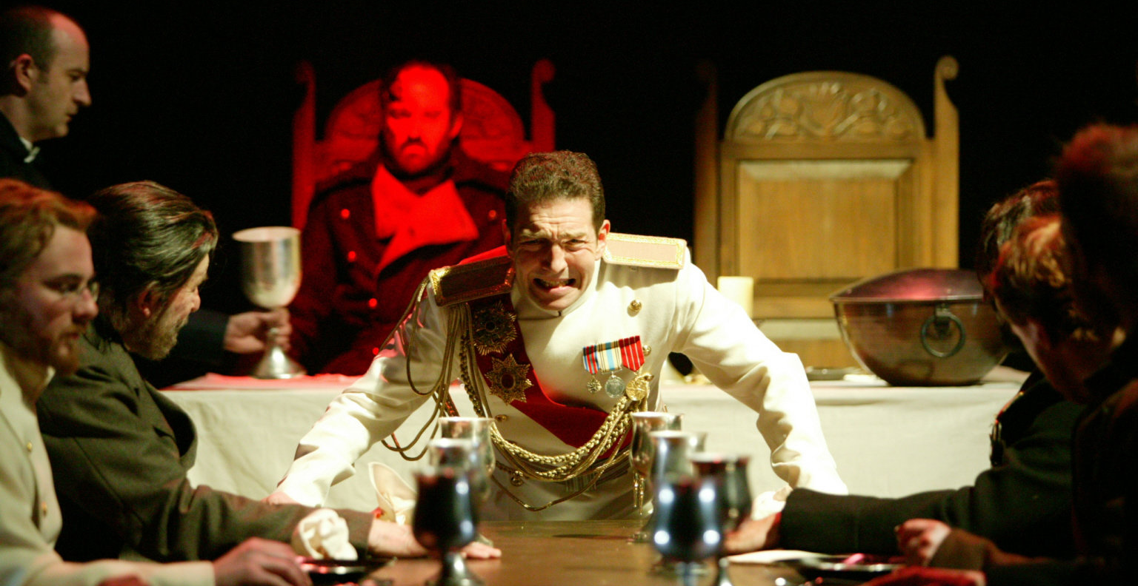
Shakespeare’s Macbeth
It is important to remember that a play can be adapted for stage and film. There are 49 film versions of Macbeth, and throughout history there have been thousands of productions of the play performed on stage.We are going to watch and discuss different versions of the opening scene of Macbeth.

Slide 4
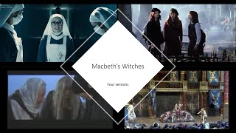

Slide 5
Turn and talk: what did you like about the 1971 version?
What did you think of the acting/staging/atmosphere?
what is the purpose of the ghost of christmas yet to come

Slide 7
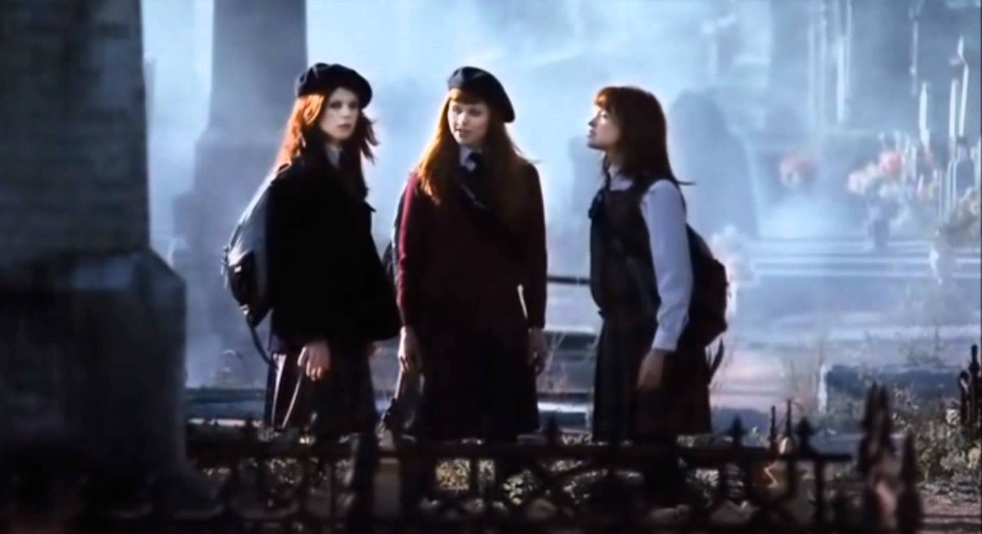
Turn and talk: what did you like about the Australian version?
What did you think of the acting/staging/atmosphere?
what is the purpose of the ghost of christmas yet to come

Slide 9
Turn and talk: what did you like about the 2006 version?
What did you think of the acting/staging/atmosphere?
what is the purpose of the ghost of christmas yet to come

Slide 11
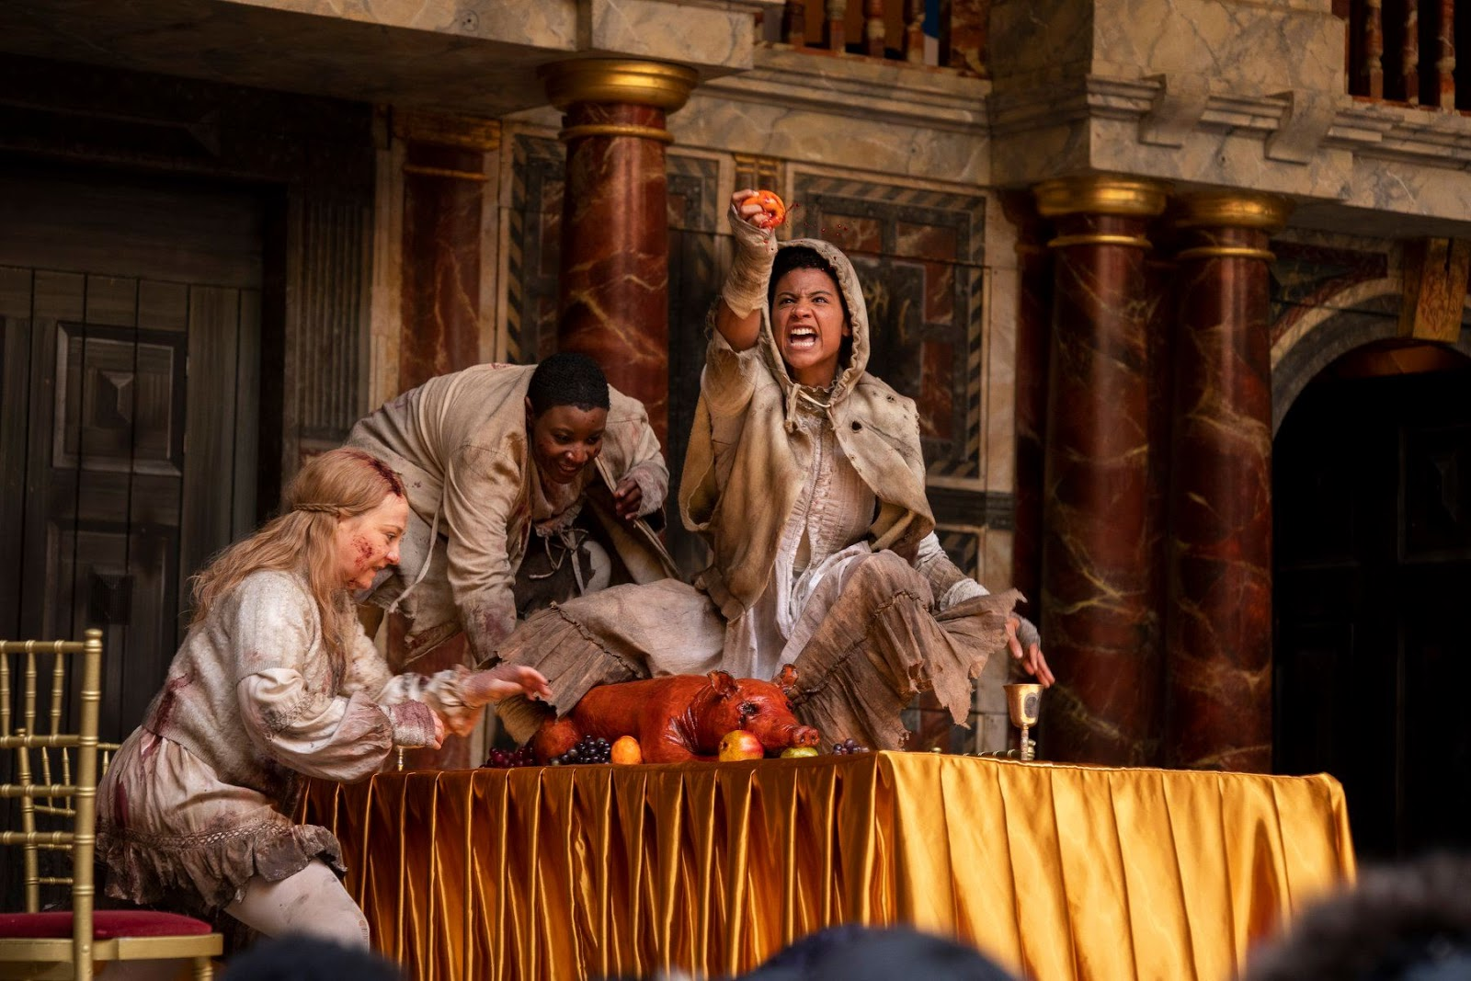
Turn and talk: what did you like about the 2020 version?
What did you think of the acting/staging/atmosphere?
what is the purpose of the ghost of christmas yet to come

Slide 12
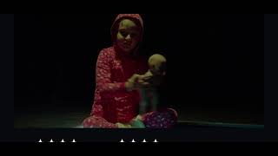

Slide 13
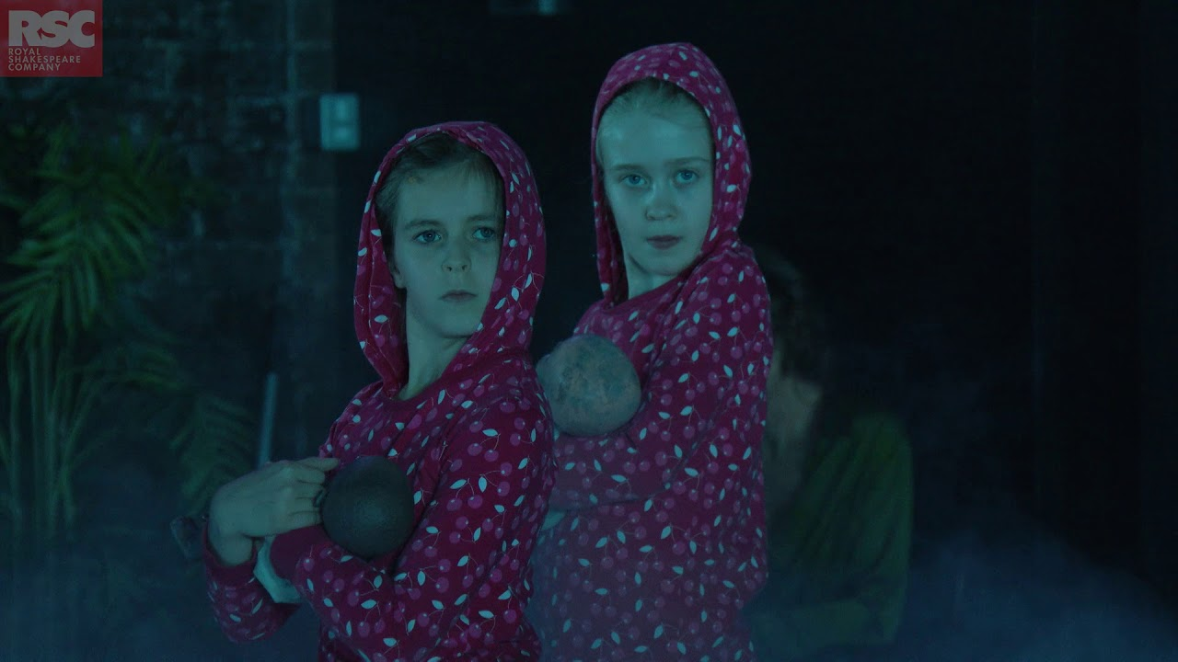
Turn and talk: what did you like about the RSC version?
What did you think of the acting/staging/atmosphere?
what is the purpose of the ghost of christmas yet to come

Slide 14

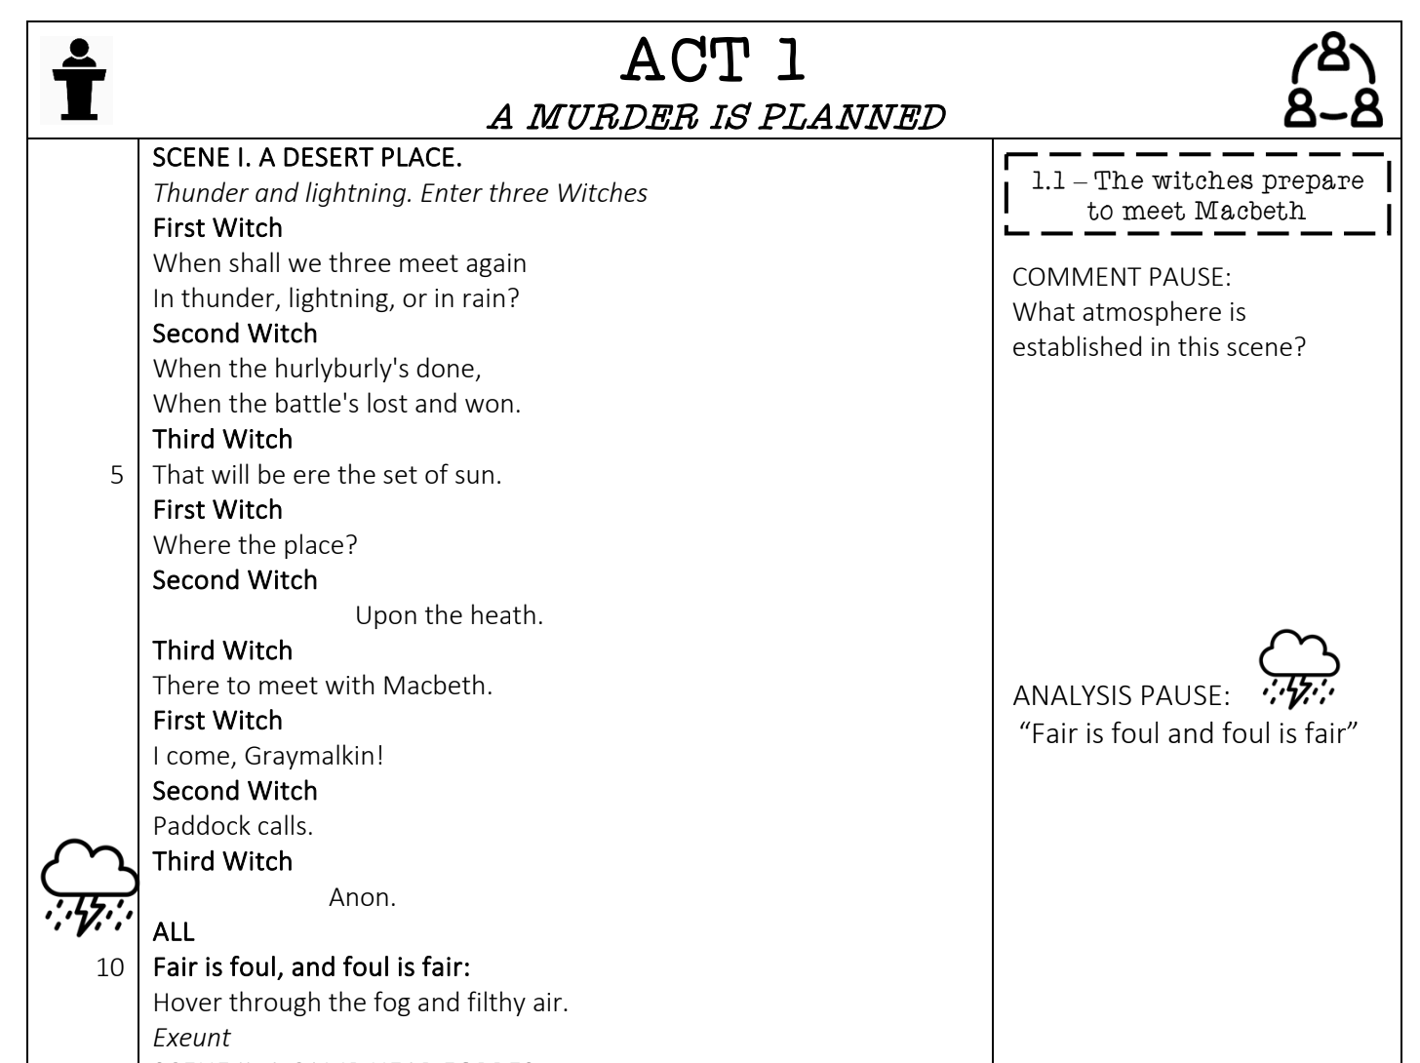
Turn to page 7: We are going to annotate the scene.

Slide 15
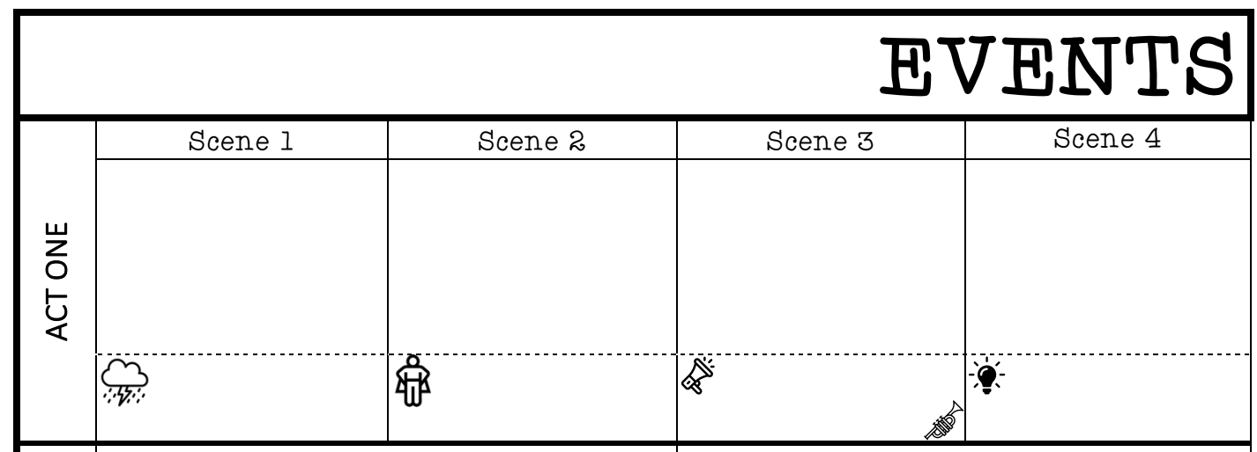
Turn to page 2: We are going to fill in a scene summary.
Write your summary here

Slide 16

End of lesson review quiz
1 | What weather do the witches meet in?
2 | What method is this?
3 | Who are the witches planning to meet?
4 | What must finish before they meet them?
5 | “Fair is _______ and ________ is fair”

Slide 17
End of lesson review quiz
1 | What weather do the witches meet in? Storm
2 | What method is this? Pathetic fallacy
3 | Who are the witches planning to meet? Macbeth
4 | What must finish before they meet them? Battle
5 | “Fair is foul and foul is fair”

