Slide 1

KIP Quiz - 28 Lessons to go!
 | Question | Text | Exam
1 | Give any quotation from act one. | Macbeth | LIT P1 - Monday 13th May
2 | Give any quotation from stave one. | A Christmas Carol | LIT P1 - Monday 13th May
3 | Give any quotation from act one. | An Inspector Calls | LIT P2 - Monday 20th May
4 | What method is “mind-forged manacles” and what poem is the quotation from? | Power and Conflict poetry | LIT P2 - Monday 20th May
5 | Which of the following is not an oxymoron? a) violent love b) troubled pleasure c) good sport | Language skills | LP1 - Thurs 23rd May, LP2 - Thurs 6th June

Slide 2


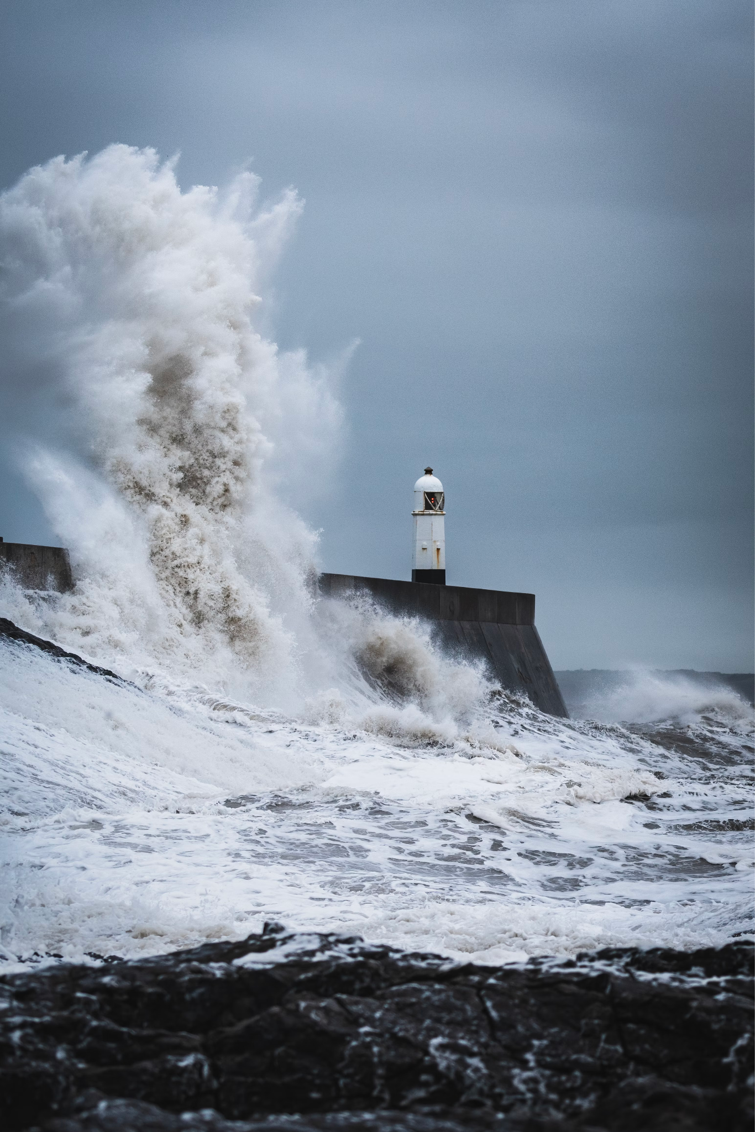
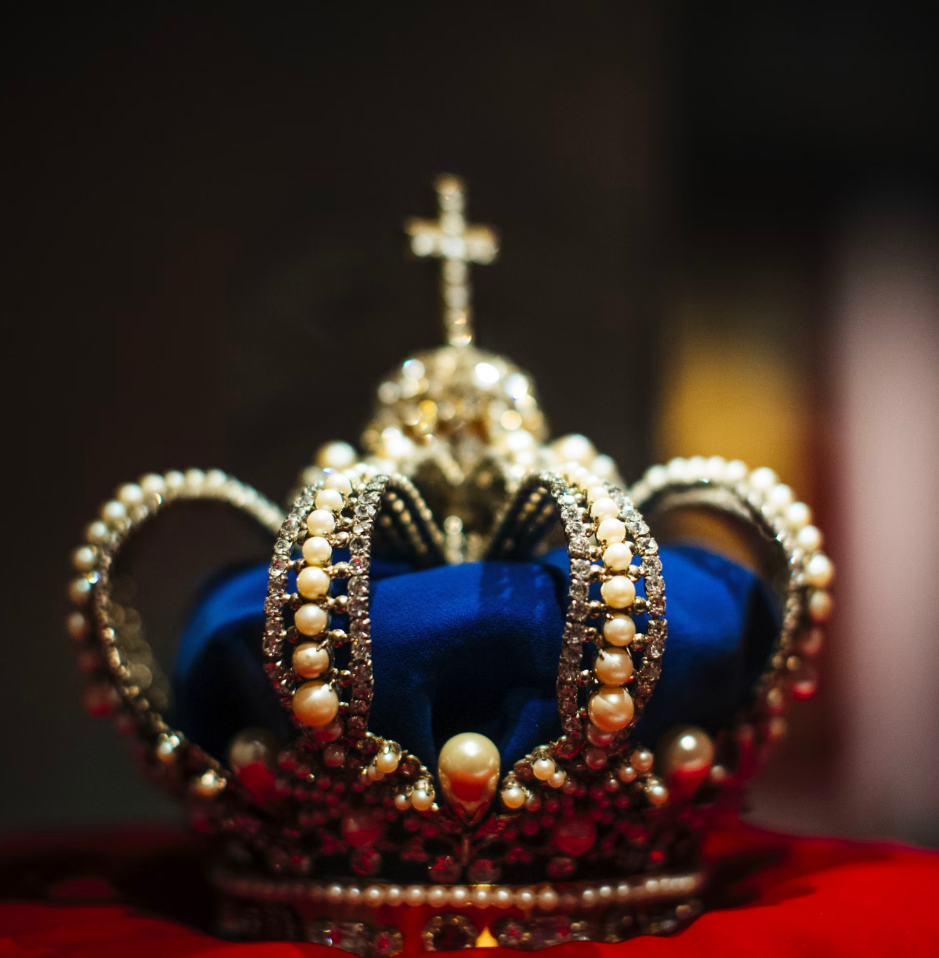
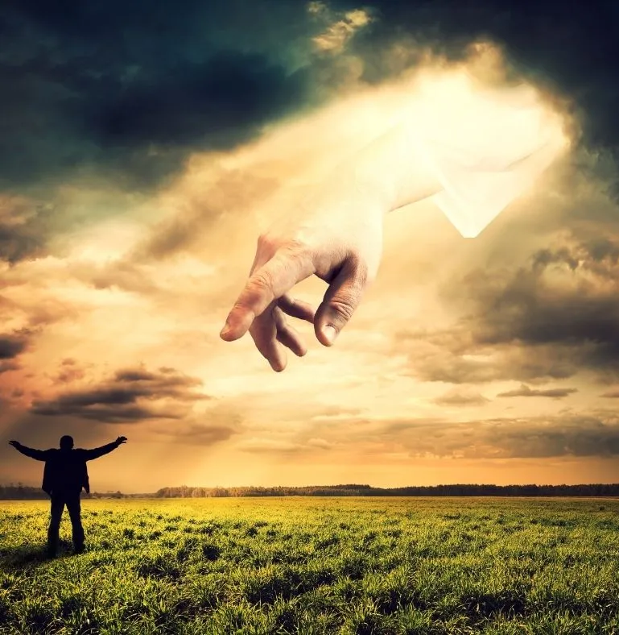
Y11: Revision - EXPLORING POWER - LIT P1
TITLE: POWER - Lit Paper 1
Monday 8th April 2024
Turn and talk: Discuss a definition of power.
What does it mean in the texts we study?

Slide 3
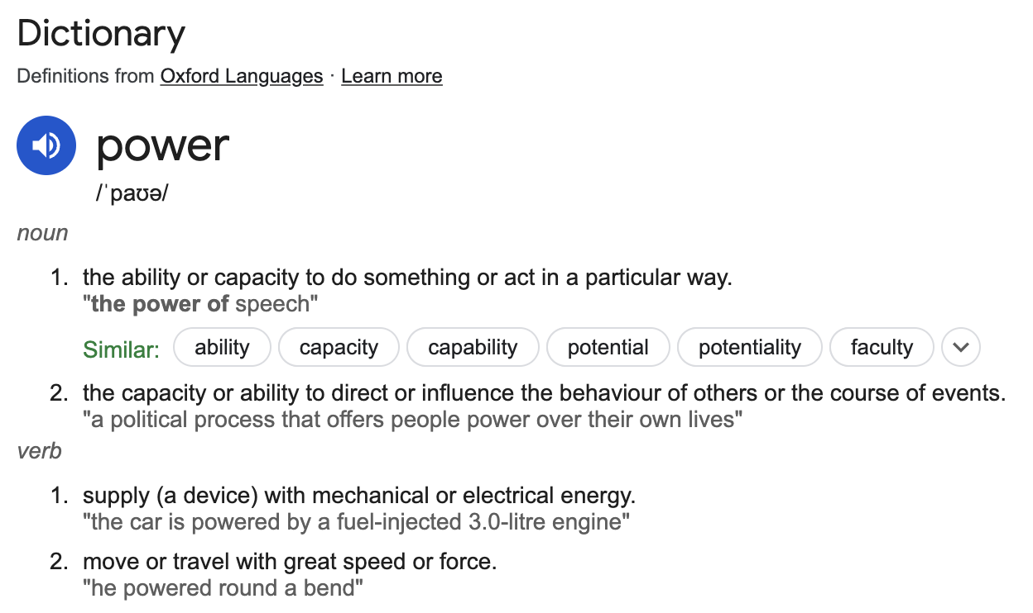
Y11: Revision - EXPLORING POWER - LIT P1

Slide 4

MACBETH
I'll fight till from my bones my flesh be hack'd.
Give me my armour.
SEYTON
'Tis not needed yet.
MACBETH
I'll put it on.
Send out more horses; skirr the country round;
Hang those that talk of fear. Give me mine armour.
How does your patient, doctor?
Doctor
Not so sick, my lord,
As she is troubled with thick coming fancies,
That keep her from her rest.
MACBETH
Cure her of that.
Read the following extract from act 5, scene 3. Macbeth is in the castle preparing for the attack.
Starting with this extract, explore how Shakespeare presents ideas about power in Macbeth [30 marks, 52.5 minutes]
SECTION A: MACBETH (13th May)

Slide 5

MACBETH
I'll fight till from my bones my flesh be hack'd.
Give me my armour.
SEYTON
'Tis not needed yet.
MACBETH
I'll put it on.
Send out more horses; skirr the country round;
Hang those that talk of fear. Give me mine armour.
How does your patient, doctor?
Doctor
Not so sick, my lord,
As she is troubled with thick coming fancies,
That keep her from her rest.
MACBETH
Cure her of that.
Read the following extract from act 5, scene 3. Macbeth is in the castle preparing for the attack.
Starting with this extract, explore how Shakespeare presents ideas about power in Macbeth [30 marks, 52.5 minutes]
SECTION A: MACBETH (13th May)

Slide 6
The owner of one scant young nose, gnawed and mumbled by the hungry cold as bones are gnawed by dogs, stooped down at Scrooge's keyhole to regale him with a Christmas carol; but, at the first sound of
"God bless you, merry gentleman, May nothing you dismay!"
Scrooge seized the ruler with such energy of action, that the singer fled in terror, leaving the keyhole to the fog, and even more congenial frost.
At length the hour of shutting up the counting-house arrived. With an ill-will Scrooge dismounted from his stool, and tacitly admitted the fact to the expectant clerk in the tank, who instantly snuffed his candle out, and put on his hat.
"You'll want all day to-morrow, I suppose?" said Scrooge.
"If quite convenient, sir."
"It's not convenient," said Scrooge, "and it's not fair. If I was to stop half-a-crown for it, you'd think yourself ill used, I'll be bound?"
Read the following extract from stave 1. Scrooge is about to close for Christmas.
Starting with this extract, explore how Dickens presents the power of the rich in A Christmas Carol [30 marks, 52.5 minutes]
SECTION B: ACCAROL (13th May)

Slide 7
The owner of one scant young nose, gnawed and mumbled by the hungry cold as bones are gnawed by dogs, stooped down at Scrooge's keyhole to regale him with a Christmas carol; but, at the first sound of
"God bless you, merry gentleman, May nothing you dismay!"
Scrooge seized the ruler with such energy of action, that the singer fled in terror, leaving the keyhole to the fog, and even more congenial frost.
At length the hour of shutting up the counting-house arrived. With an ill-will Scrooge dismounted from his stool, and tacitly admitted the fact to the expectant clerk in the tank, who instantly snuffed his candle out, and put on his hat.
"You'll want all day to-morrow, I suppose?" said Scrooge.
"If quite convenient, sir."
"It's not convenient," said Scrooge, "and it's not fair. If I was to stop half-a-crown for it, you'd think yourself ill used, I'll be bound?"
Read the following extract from stave 1. Scrooge is about to close for Christmas.
Starting with this extract, explore how Dickens presents the power of the rich in A Christmas Carol [30 marks, 52.5 minutes]
SECTION B: ACCAROL (13th May)

Slide 8
The owner of one scant young nose, gnawed and mumbled by the hungry cold as bones are gnawed by dogs, stooped down at Scrooge's keyhole to regale him with a Christmas carol; but, at the first sound of
"God bless you, merry gentleman, May nothing you dismay!"
Scrooge seized the ruler with such energy of action, that the singer fled in terror, leaving the keyhole to the fog, and even more congenial frost.
At length the hour of shutting up the counting-house arrived. With an ill-will Scrooge dismounted from his stool, and tacitly admitted the fact to the expectant clerk in the tank, who instantly snuffed his candle out, and put on his hat.
"You'll want all day to-morrow, I suppose?" said Scrooge.
"If quite convenient, sir."
"It's not convenient," said Scrooge, "and it's not fair. If I was to stop half-a-crown for it, you'd think yourself ill used, I'll be bound?"
Read the following extract from stave 1. Scrooge is about to close for Christmas.
Starting with this extract, explore how Dickens presents the power of the rich in A Christmas Carol [30 marks, 52.5 minutes]
SECTION B: ACCAROL (13th May)

Slide 9
KIP Quiz - 27 Lessons to go!
 | Question | Text | Exam
1 | Give any quotation from act two. | Macbeth | LIT P1 - Monday 13th May
2 | Give any quotation from stave two. | A Christmas Carol | LIT P1 - Monday 13th May
3 | Give any quotation from act two. | An Inspector Calls | LIT P2 - Monday 20th May
4 | What method is “merciless iced east winds that knife us” and what poem is the quotation from? | Power and Conflict poetry | LIT P2 - Monday 20th May
5 | Identify the verb(s) in the following sentence: I read Macbeth and created a detailed mindmap. | Language skills | LP1 - Thurs 23rd May, LP2 - Thurs 6th June

Slide 10
Y11: Revision - EXPLORING POWER - LIT P1
TITLE: POWER - Lit Paper 2
Tuesday 9th April 2024
Turn and talk: Recap a definition of power and discuss
the message about power in An Inspector Calls.

Slide 11
Either
01 Explore how Priestley presents the way the upper classes abuse their power in An Inspector Calls.
or
02 Explore how Priestley presents Eva Smith as an example of the powerless lower class.
SECTION A: AICALLS (20th May)

Slide 12
Either
01 Explore how Priestley presents the way the upper classes abuse their power in An Inspector Calls.
or
02 Explore how Priestley presents Eva Smith as an example of the powerless lower class.
SECTION A: AICALLS (20th May)

Slide 13
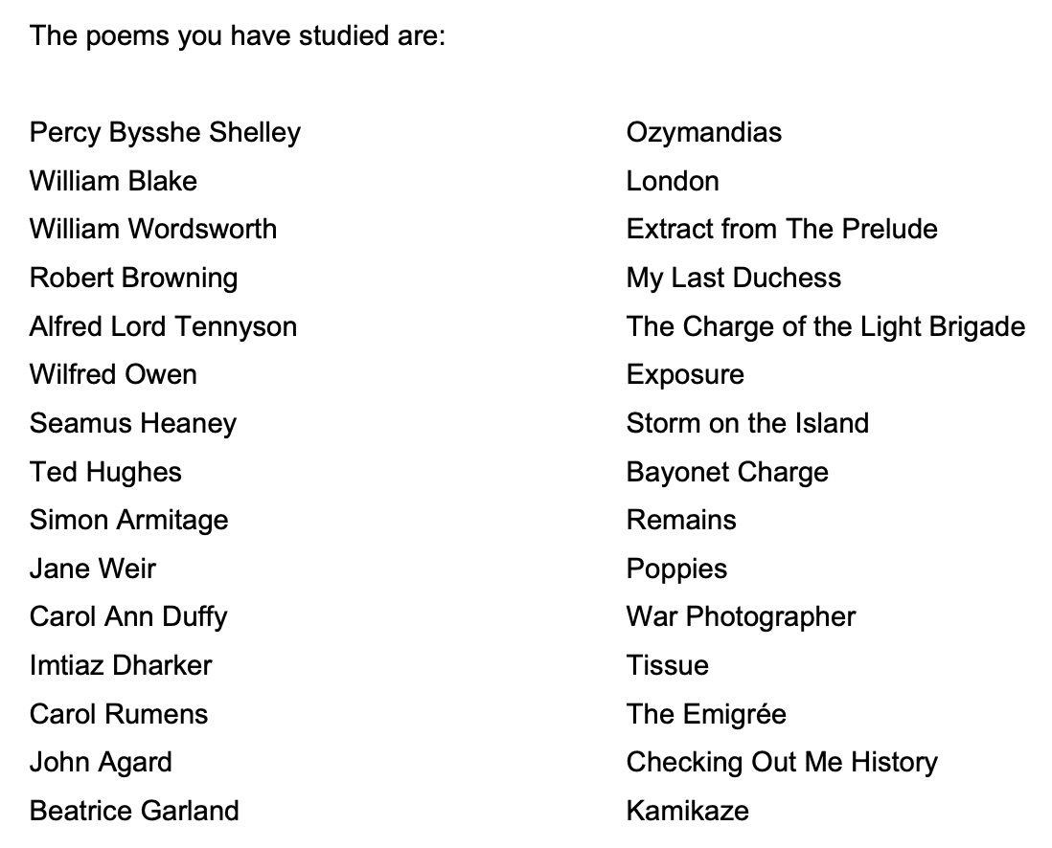
Turn and talk: Discuss which poems explore power that is
similar to ‘Exposure’.
Compare how poets present ideas about power in ‘Exposure’ and one other poem.
SECTION B: POETRY (20th May)

Slide 14
Our brains ache, in the merciless iced east winds that knive us . . .
Wearied we keep awake because the night is silent . . .
Low drooping flares confuse our memory of the salient . . .
Worried by silence, sentries whisper, curious, nervous,
But nothing happens.
Watching, we hear the mad gusts tugging on the wire,
Like twitching agonies of men among its brambles.
Northward, incessantly, the flickering gunnery rumbles,
Far off, like a dull rumour of some other war.
What are we doing here?
The poignant misery of dawn begins to grow . . .
We only know war lasts, rain soaks, and clouds sag stormy.
Dawn massing in the east her melancholy army
Attacks once more in ranks on shivering ranks of grey,
But nothing happens.
Sudden successive flights of bullets streak the silence.
Less deadly than the air that shudders black with snow,
With sidelong flowing flakes that flock, pause, and renew,
We watch them wandering up and down the wind's nonchalance,
But nothing happens.
Pale flakes with fingering stealth come feeling for our faces—
We cringe in holes, back on forgotten dreams, and stare, snow-dazed,
Deep into grassier ditches. So we drowse, sun-dozed,
Littered with blossoms trickling where the blackbird fusses.
—Is it that we are dying?
Slowly our ghosts drag home: glimpsing the sunk fires, glozed
With crusted dark-red jewels; crickets jingle there;
For hours the innocent mice rejoice: the house is theirs;
Shutters and doors, all closed: on us the doors are closed,—
We turn back to our dying.
Since we believe not otherwise can kind fires burn;
Now ever suns smile true on child, or field, or fruit.
For God's invincible spring our love is made afraid;
Therefore, not loath, we lie out here; therefore were born,
For love of God seems dying.
Tonight, this frost will fasten on this mud and us,
Shrivelling many hands, and puckering foreheads crisp.
The burying-party, picks and shovels in shaking grasp,
Pause over half-known faces. All their eyes are ice,
But nothing happens.
Compare how poets present ideas about power in ‘Exposure’ and one other poem.
SECTION B: POETRY (20th May)

Slide 15
Our brains ache, in the merciless iced east winds that knive us . . .
Wearied we keep awake because the night is silent . . .
Low drooping flares confuse our memory of the salient . . .
Worried by silence, sentries whisper, curious, nervous,
But nothing happens.
Watching, we hear the mad gusts tugging on the wire,
Like twitching agonies of men among its brambles.
Northward, incessantly, the flickering gunnery rumbles,
Far off, like a dull rumour of some other war.
What are we doing here?
The poignant misery of dawn begins to grow . . .
We only know war lasts, rain soaks, and clouds sag stormy.
Dawn massing in the east her melancholy army
Attacks once more in ranks on shivering ranks of grey,
But nothing happens.
Sudden successive flights of bullets streak the silence.
Less deadly than the air that shudders black with snow,
With sidelong flowing flakes that flock, pause, and renew,
We watch them wandering up and down the wind's nonchalance,
But nothing happens.
Pale flakes with fingering stealth come feeling for our faces—
We cringe in holes, back on forgotten dreams, and stare, snow-dazed,
Deep into grassier ditches. So we drowse, sun-dozed,
Littered with blossoms trickling where the blackbird fusses.
—Is it that we are dying?
Slowly our ghosts drag home: glimpsing the sunk fires, glozed
With crusted dark-red jewels; crickets jingle there;
For hours the innocent mice rejoice: the house is theirs;
Shutters and doors, all closed: on us the doors are closed,—
We turn back to our dying.
Since we believe not otherwise can kind fires burn;
Now ever suns smile true on child, or field, or fruit.
For God's invincible spring our love is made afraid;
Therefore, not loath, we lie out here; therefore were born,
For love of God seems dying.
Tonight, this frost will fasten on this mud and us,
Shrivelling many hands, and puckering foreheads crisp.
The burying-party, picks and shovels in shaking grasp,
Pause over half-known faces. All their eyes are ice,
But nothing happens.
Compare how poets present ideas about power in ‘Exposure’ and one other poem.
SECTION B: POETRY (20th May)

Slide 16
KIP Quiz - 26 Lessons to go!
 | Question | Text | Exam
1 | Give any quotation from act three. | Macbeth | LIT P1 - Monday 13th May
2 | Give any quotation from stave three. | A Christmas Carol | LIT P1 - Monday 13th May
3 | Give any quotation from act three. | An Inspector Calls | LIT P2 - Monday 20th May
4 | What method is “bright, filled paperweight” and what poem is the quotation from? | Power and Conflict poetry | LIT P2 - Monday 20th May
5 | Identify the adjective(s) in the following sentence: “Spring-time in the haggard winter of his life” | Language skills | LP1 - Thurs 23rd May, LP2 - Thurs 6th June

Slide 17
Y11: Revision - EXPLORING POWER - LANG P1
TITLE: POWER - Lang Paper 1
Date

Slide 18
Y11: Revision - EXPLORING POWER - ALL LIT
Turn and talk: What does each text teach us about power?
Use words like criticises/ challenges/ educates/ teaches
Dickens
Shakespeare
WRITERS’ MESSAGES ABOUT POWER
Heaney
Priestley
Poetry
Owen
Shelley

Slide 19
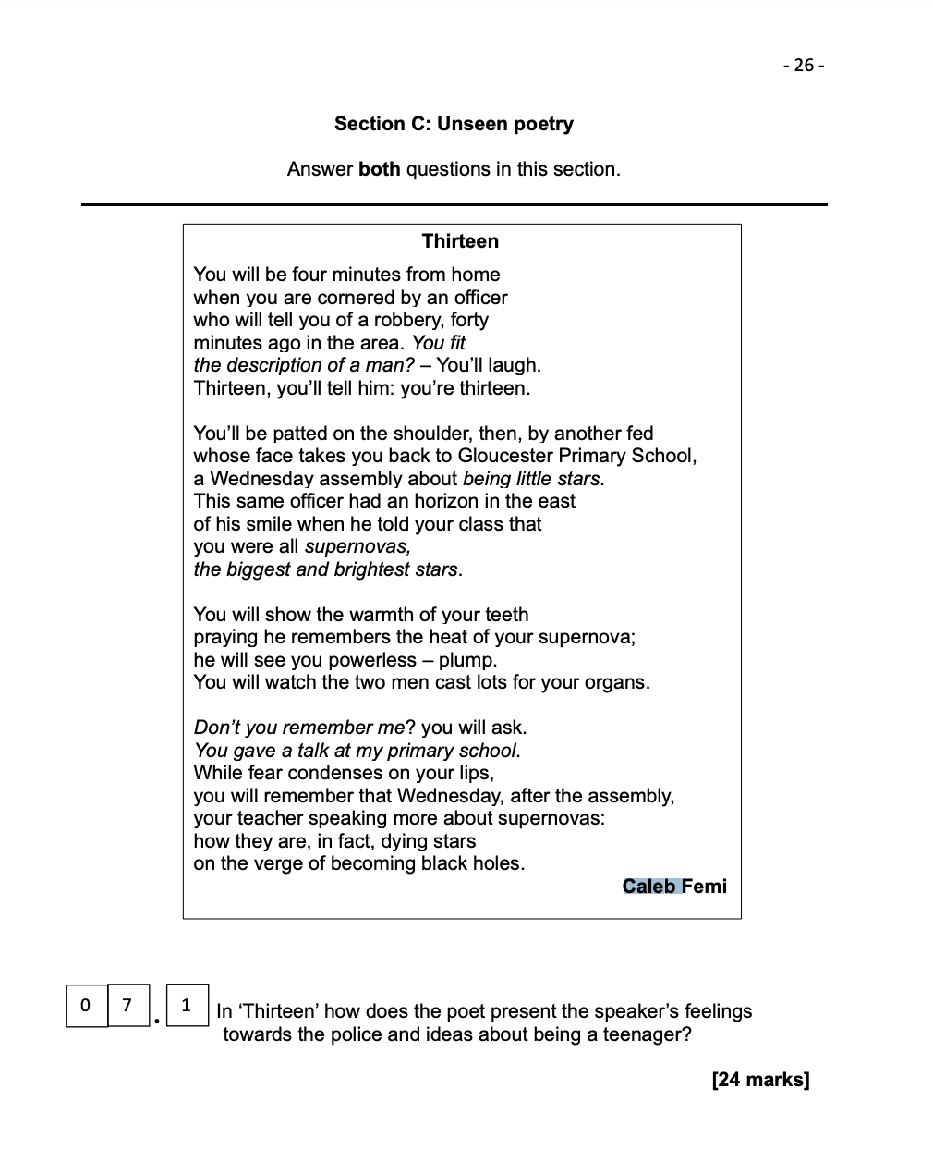
Turn to page 26 in your unseen poetry booklet.
In ‘Thirteen’ how does the poet present the speaker’s feelings towards the police and ideas about being a teenager?
First, we will watch the poet read the poem (bear in mind that you won’t get this in the exam!)
SECTION C: UNSEEN POETRY (20th May)

Slide 20
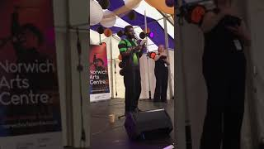
SECTION C: UNSEEN POETRY (20th May)

Slide 21
In ‘Thirteen’ how does the poet present the speaker’s feelings towards the police and ideas about being a teenager?
You have 3 minutes to decide your three quotations and then write an opening answer: Overall, Femi presents…
SECTION C: UNSEEN POETRY (20th May)

Slide 22
KIP Quiz - 25 Lessons to go!
 | Question | Text | Exam
1 | Give any quotation from act four. | Macbeth | LIT P1 - Monday 13th May
2 | Give any quotation from stave four. | A Christmas Carol | LIT P1 - Monday 13th May
3 | Give any quotation for Eva being powerless. | An Inspector Calls | LIT P2 - Monday 20th May
4 | What method is “troubled pleasure” and what poem is the quotation from? | Power and Conflict poetry | LIT P2 - Monday 20th May
5 | Identify the adverb(s) in the following sentence: Quickly and cautiously, he hurried down the very empty street, extremely concerned about getting caught. | Language skills | LP1 - Thurs 23rd May, LP2 - Thurs 6th June

Slide 23
Y11: Revision - EXPLORING POWER - LANG P2
TITLE: POWER - Lang Paper 2
Date

Slide 24
Y11: Revision - EXPLORING POWER - Lang P1
Turn and talk: With the person next to you, recap the
five questions that come up in language paper 1.
Q | Marks | Time | Task
1 | 4 | 5
2 | 8 | 10
3 | 8 | 10
4 | 20 | 25
5 | 40 | 45
LANGUAGE PAPER ONE - FICTION (Thursday 23rd May)

Slide 25
Y11: Revision - EXPLORING POWER - Lang P1
Q | Marks | Time | Task
1 | 4 | 5
2 | 8 | 10
3 | 8 | 10
4 | 20 | 25
5 | 40 | 45
List four things
Language analysis of an extract
Structure analysis of an extract
Responding to a statement
Creative writing from an image
LANGUAGE PAPER ONE - FICTION (Thursday 23rd May)

Slide 26
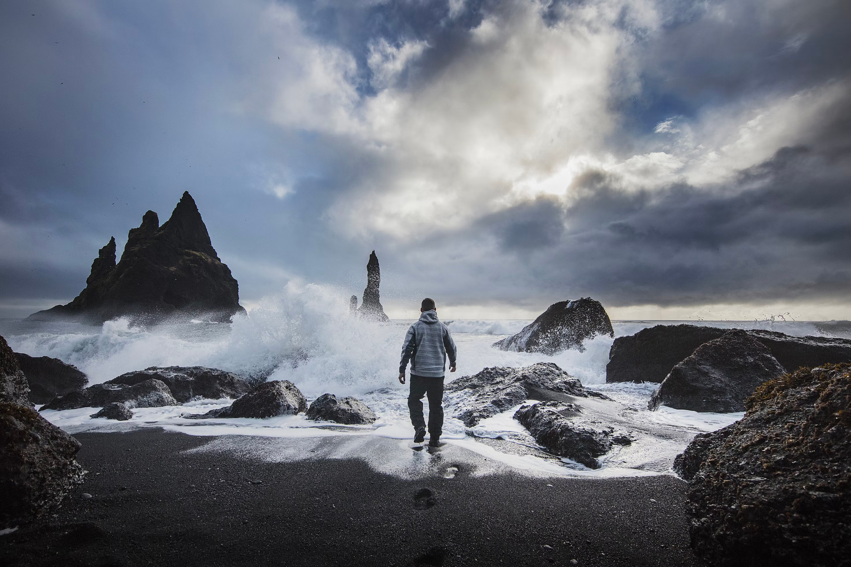
Y11: Revision - EXPLORING POWER - Lang P1
05 Either
Write a description suggested by this picture
or
Write the opening of a story about powerful
weather
LANGUAGE PAPER ONE - FICTION (Thursday 23rd May)

Slide 27
KIP Quiz - 24 Lessons to go!
 | Question | Text | Exam
1 | Give any quotation from act five. | Macbeth | LIT P1 - Monday 13th May
2 | Give any quotation from stave five. | A Christmas Carol | LIT P1 - Monday 13th May
3 | Give any quotation linked to abuse of power. | An Inspector Calls | LIT P2 - Monday 20th May
4 | What method is “spits like a tame cat turned savage” and what poem is the quotation from? | Power and Conflict poetry | LIT P2 - Monday 20th May
5 | Write a sentence about a storm using a purposeful simile (think carefully about what you are comparing - no cheesy/ boring/ quick similes!) | Language skills | LP1 - Thurs 23rd May, LP2 - Thurs 6th June

Slide 28
Y11: Revision - EXPLORING POWER - Lang P2
Turn and talk: With the person next to you, recap the
five questions that come up in language paper 2.
Q | Marks | Time | Task
1 | 4 | 5
2 | 8 | 10
3 | 12 | 15
4 | 16 | 20
5 | 40 | 45
LANGUAGE PAPER TWO - NON- FICTION (Thursday 6th June)

Slide 29
Y11: Revision - EXPLORING POWER - Lang P2
Q | Marks | Time | Task
1 | 4 | 5
2 | 8 | 10
3 | 12 | 15
4 | 16 | 20
5 | 40 | 45
Four true/false statements
Summarising the similarities/differences
Language analysis of an extract
Comparison of writers’ viewpoints
Viewpoint writing from a statement
LANGUAGE PAPER TWO - NON- FICTION (Thursday 6th June)

Slide 30
Y11: Revision - EXPLORING POWER - Lang P2
05 ‘Those who have power should support those in situations of need. It is selfish, egotistical and narrow-minded to not care about people who face hardships.’
Write a speech offering your views on this statement.
(24 marks for content and organisation, 16 marks for technical accuracy)
[40 marks]
You are advised to plan your answer to Question 5 before you start to write.
LANGUAGE PAPER TWO - NON- FICTION (Thursday 6th June)

