Slide 1

Welcome to
Language paper 2
Revision

Slide 2
Complete question 1

Slide 3
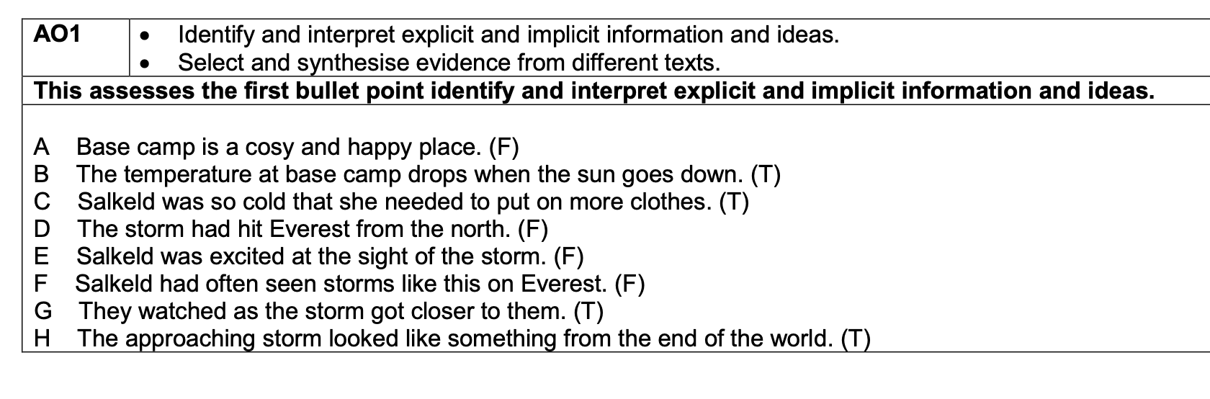
Question 1 answers
BCGH

Slide 4
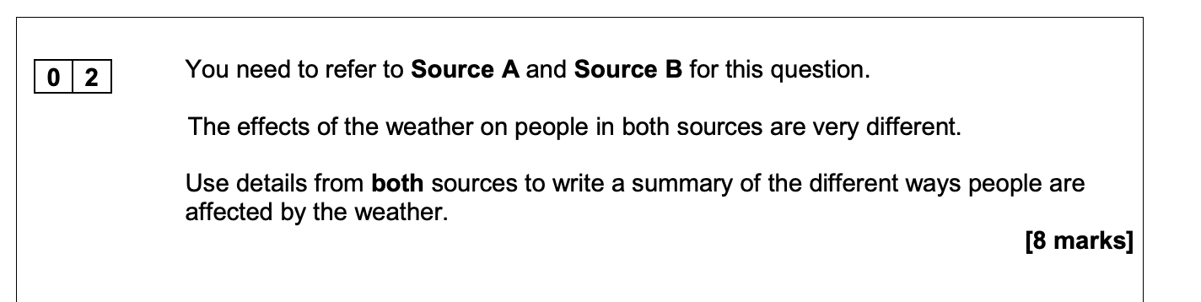
Question 2: initial ideas
Difference - Quotation - Suggestion

Slide 5
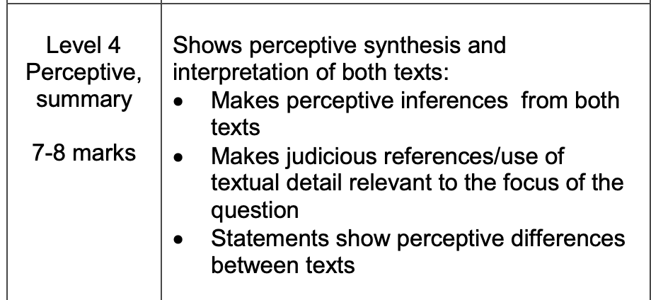
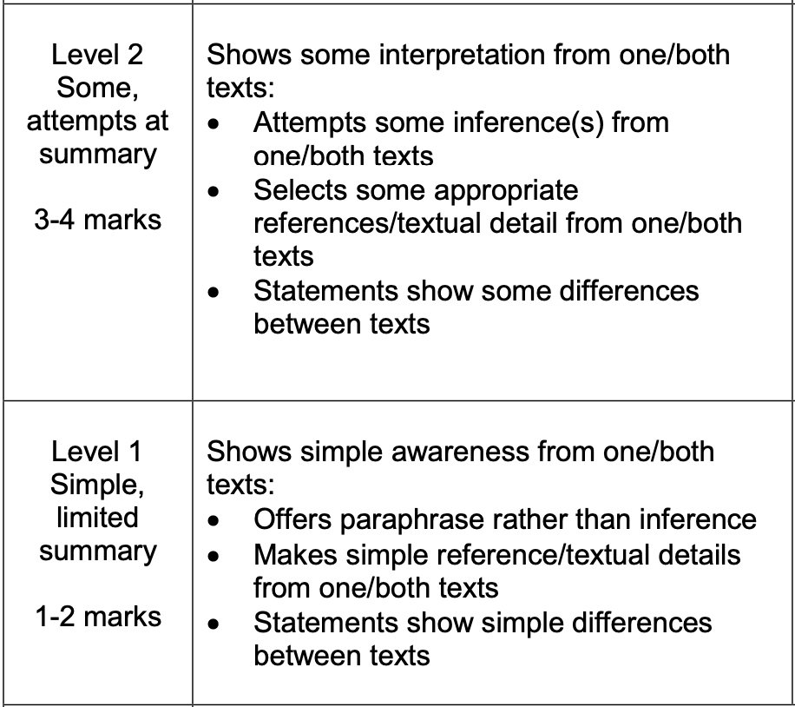
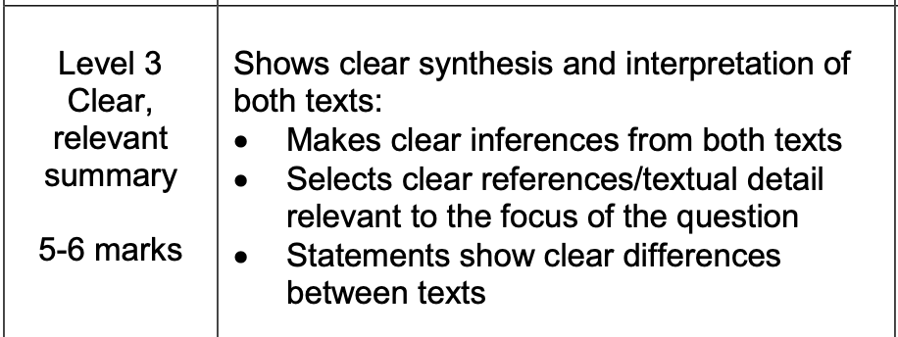
Question 2 mark scheme

Slide 6
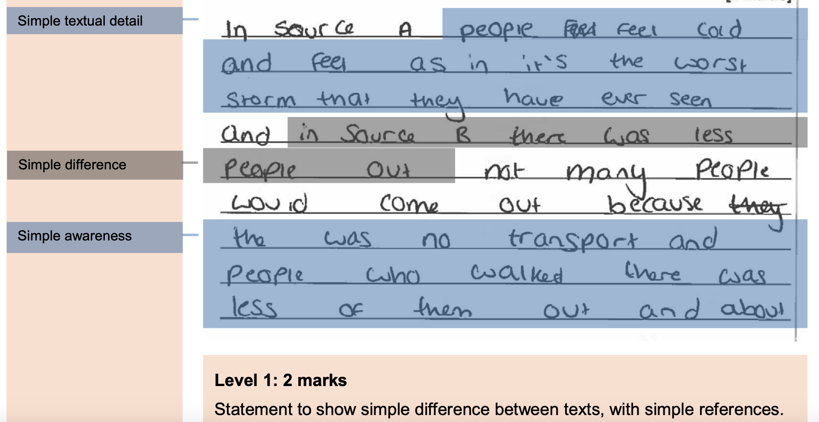
T&T: What mark might this be?

Slide 7
Q2 Example 1: marks explained

Slide 8
Q2 mark scheme
Level | Skill Descriptors
Level 4 Perceptive, detailed 7-8 marks | ·Shows a detailed understanding of differences between the texts ·Offers perceptive interpretation of both texts ·Synthesises evidence between texts ·Selects a range of judicious quotations from both texts
Level 3 Clear, relevant 5-6 marks | ·Shows a clear understanding of differences between the texts ·Begins to interpret both texts ·Demonstrates clear connections between texts ·Selects relevant quotations/references from both texts to support response
Level 2 Some, attempts 3-4 marks | ·Identifies some differences between the texts ·Attempts some inference from one/both texts ·Attempts to link evidence between texts ·Selects some quotations/references; not always supporting (from one/both texts)
Level 1 Simple, limited 1-2 marks | ·Shows simple awareness of difference(s) ·Offers paraphrase rather than inference ·Makes simple or no links between texts ·Simple reference or textual details from one/both texts
Level 0 No marks | Candidates in this band will not have offered any differences Nothing to reward

Slide 9
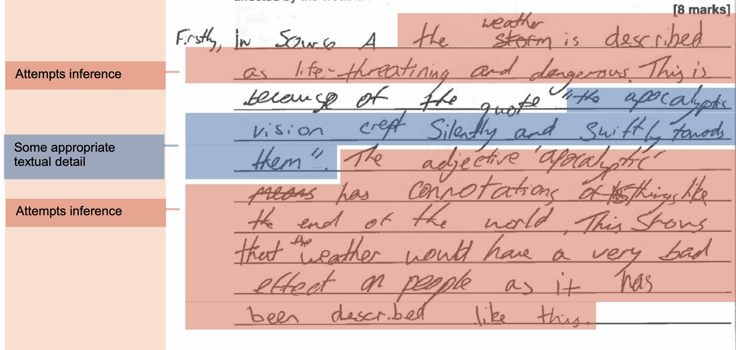
T&T: Why is this better?

Slide 10
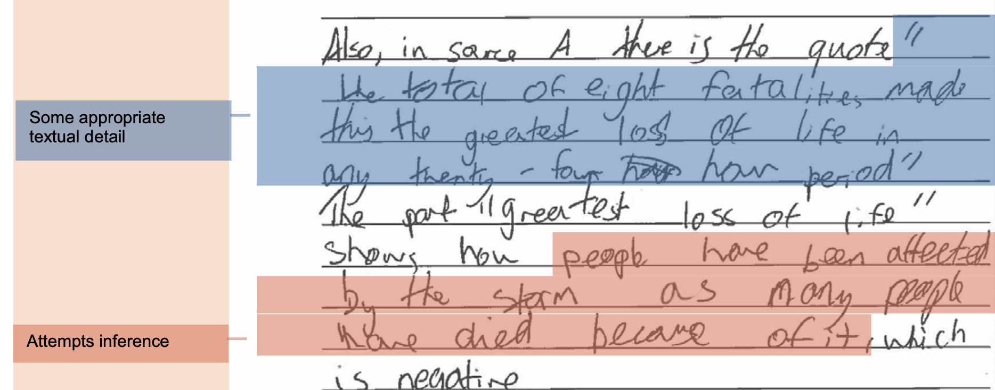
T&T: Why is this better?

Slide 11
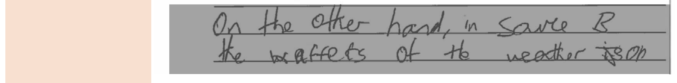
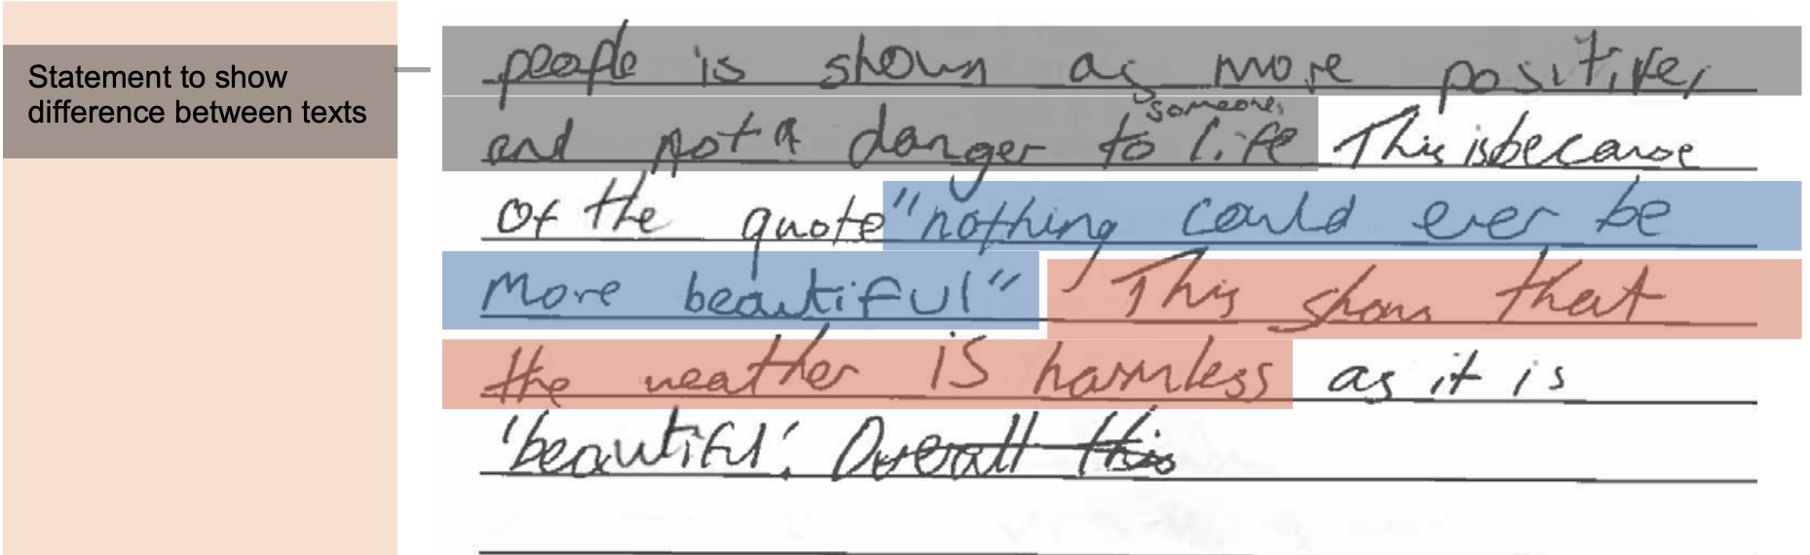
T&T: Why is this better?

Slide 12
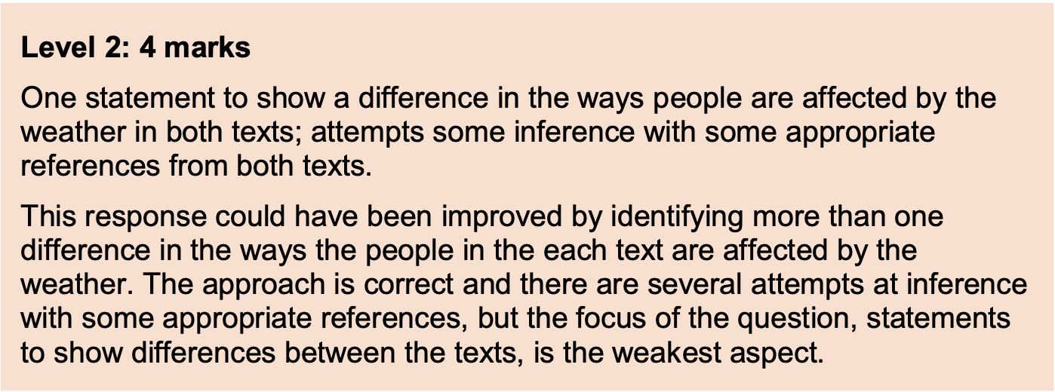
Q2 Example 2: marks explained

Slide 13
Your turn - you must write a response that is better!
Level | Skill Descriptors
Level 4 Perceptive, detailed 7-8 marks | ·Shows a detailed understanding of differences between the texts ·Offers perceptive interpretation of both texts ·Synthesises evidence between texts ·Selects a range of judicious quotations from both texts
Level 3 Clear, relevant 5-6 marks | ·Shows a clear understanding of differences between the texts ·Begins to interpret both texts ·Demonstrates clear connections between texts ·Selects relevant quotations/references from both texts to support response
Level 2 Some, attempts 3-4 marks | ·Identifies some differences between the texts ·Attempts some inference from one/both texts ·Attempts to link evidence between texts ·Selects some quotations/references; not always supporting (from one/both texts)
Level 1 Simple, limited 1-2 marks | ·Shows simple awareness of difference(s) ·Offers paraphrase rather than inference ·Makes simple or no links between texts ·Simple reference or textual details from one/both texts
Level 0 No marks | Candidates in this band will not have offered any differences Nothing to reward

Slide 14
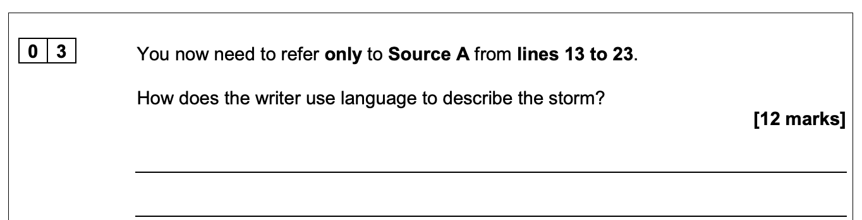
Question 3: initial ideas
What - How - How

Slide 15
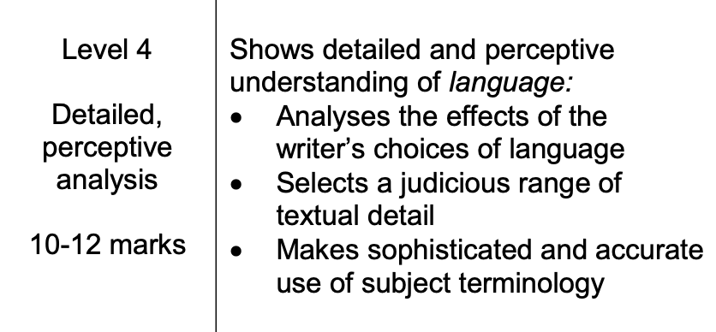
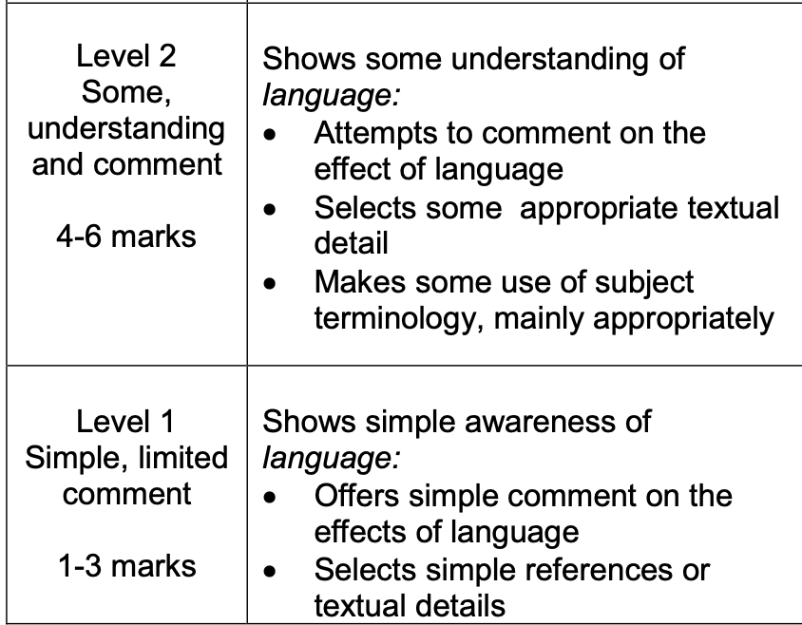
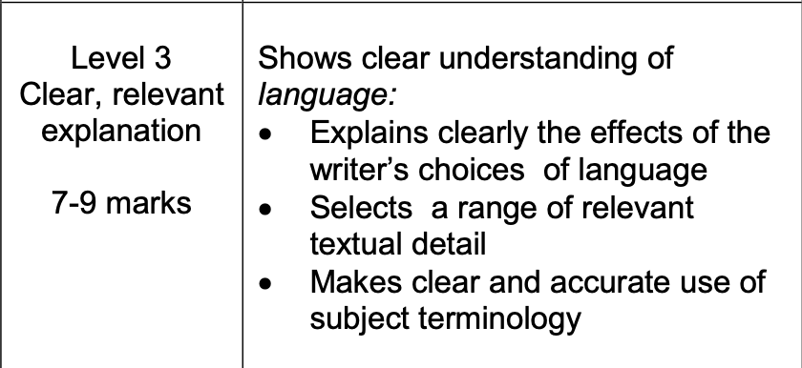
Question 3 mark scheme

Slide 16
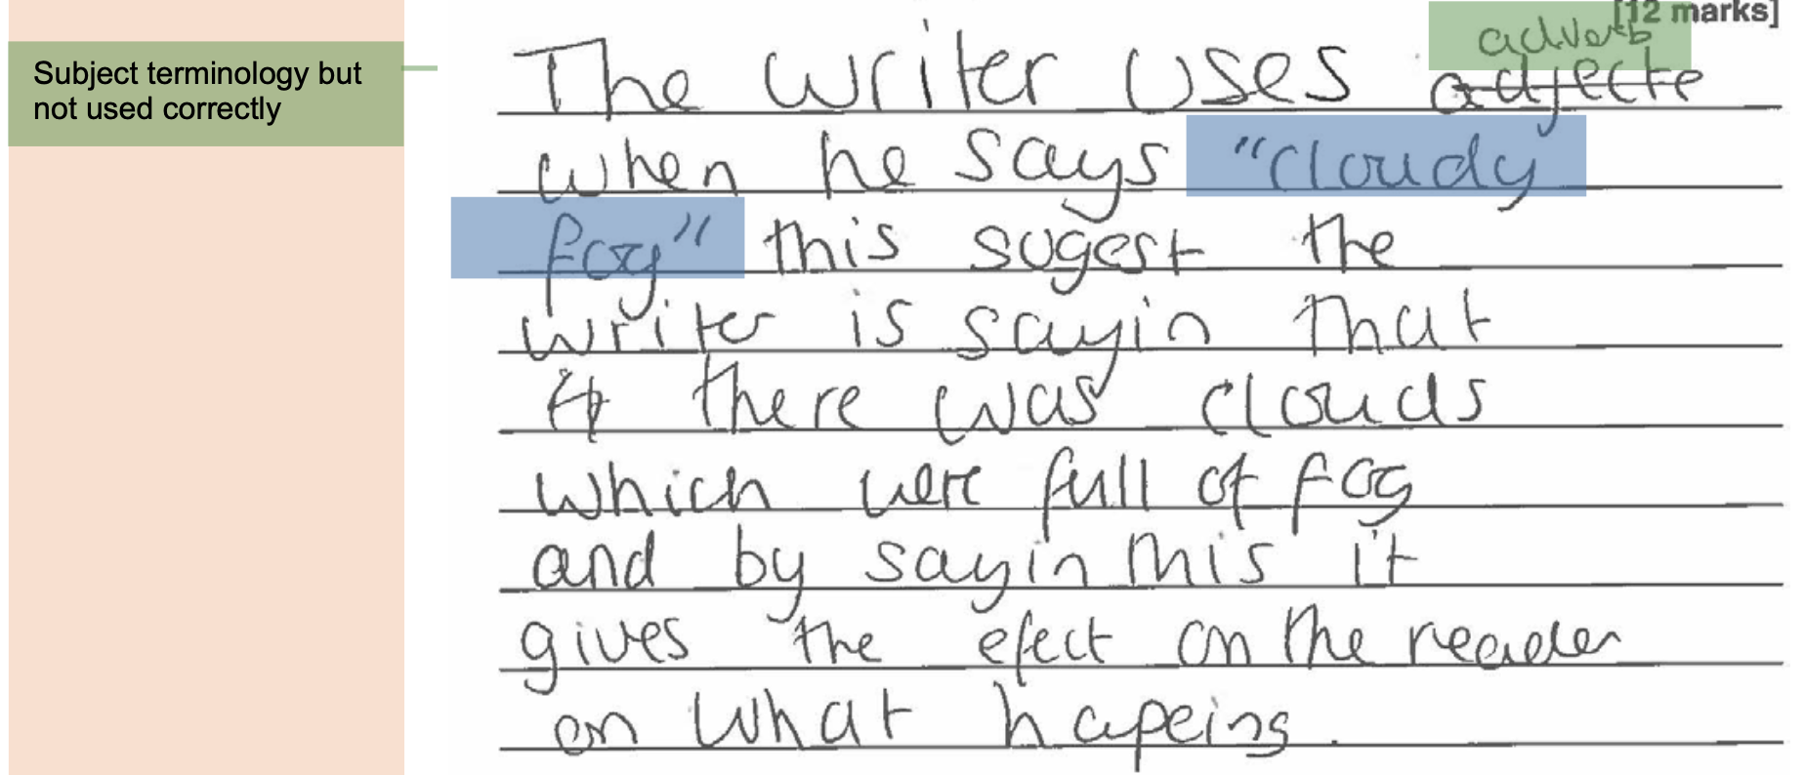
T&T: What mark might this be?

Slide 17
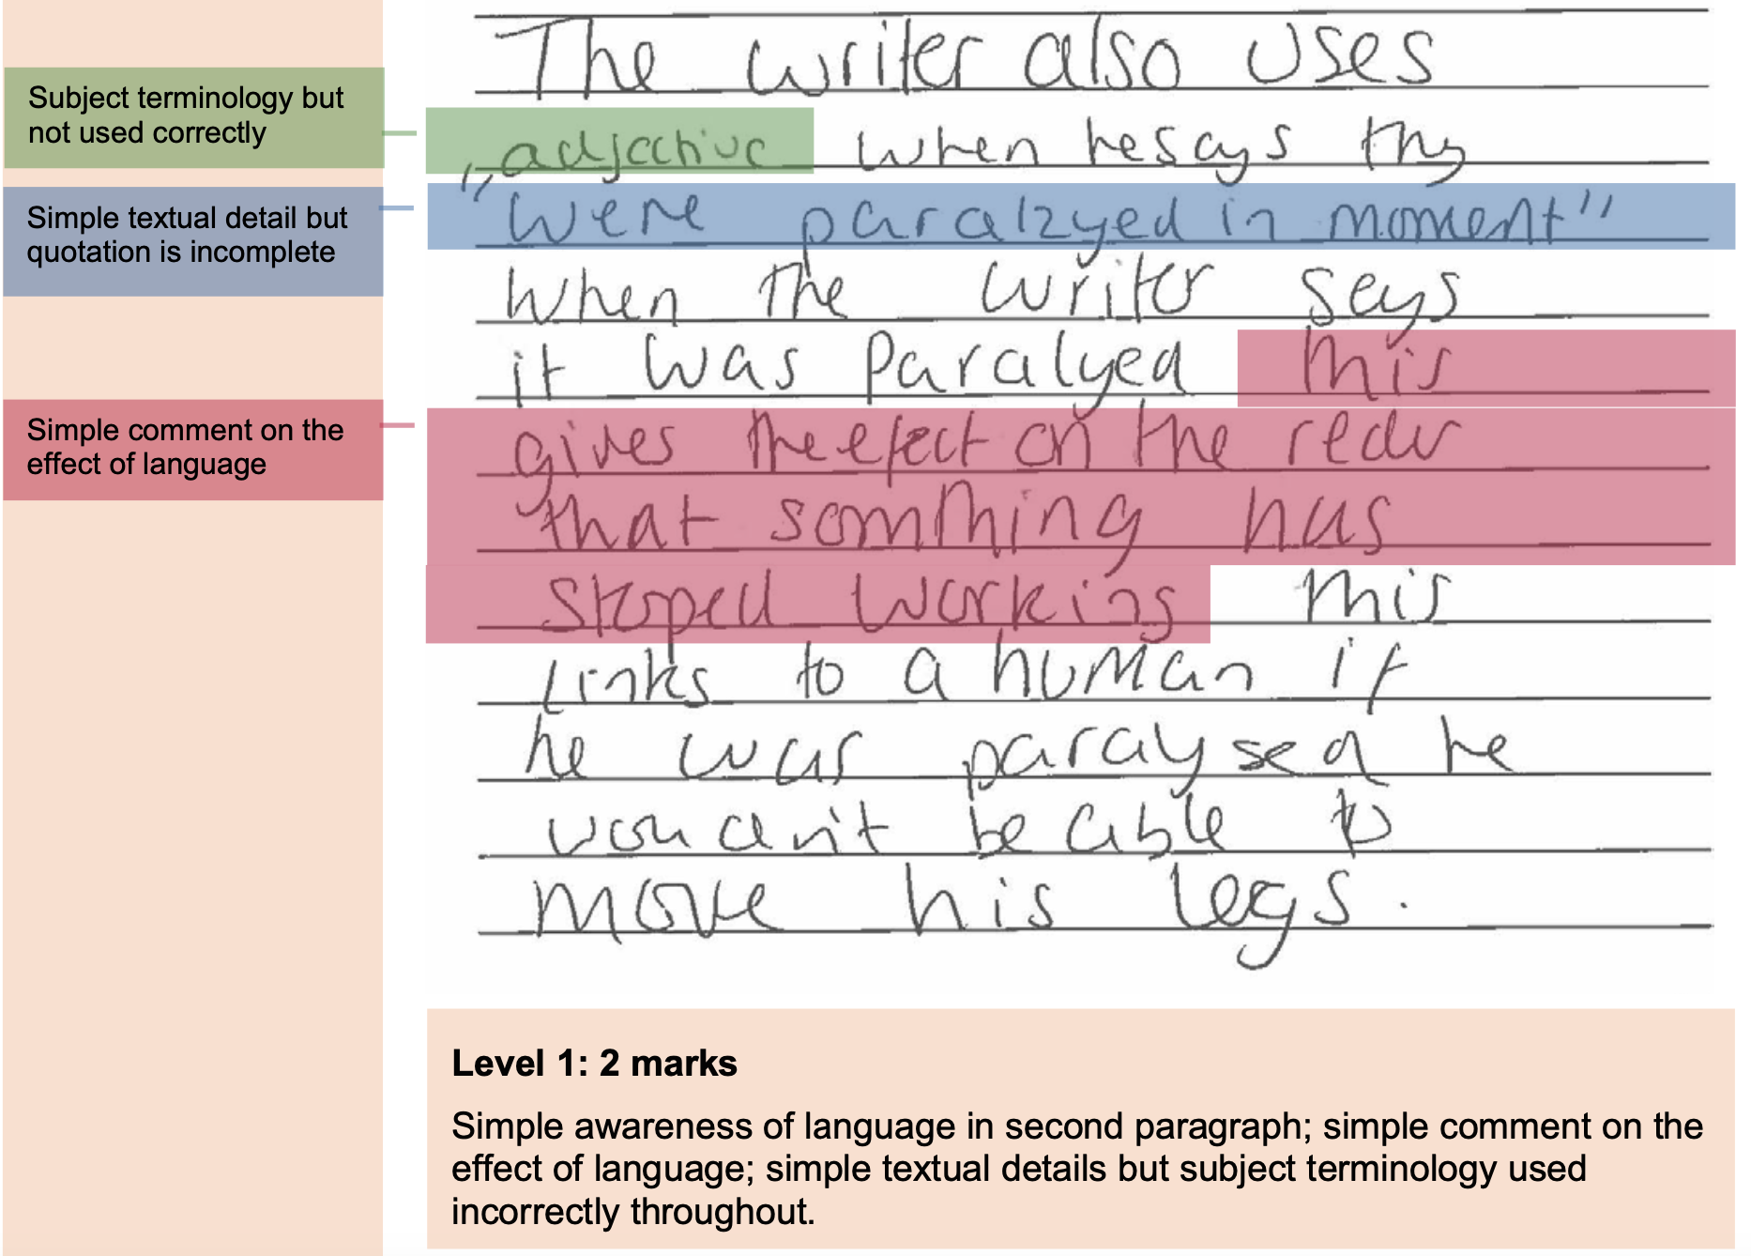
T&T: What mark might this be?

Slide 19
Question 3 mark scheme

Slide 20
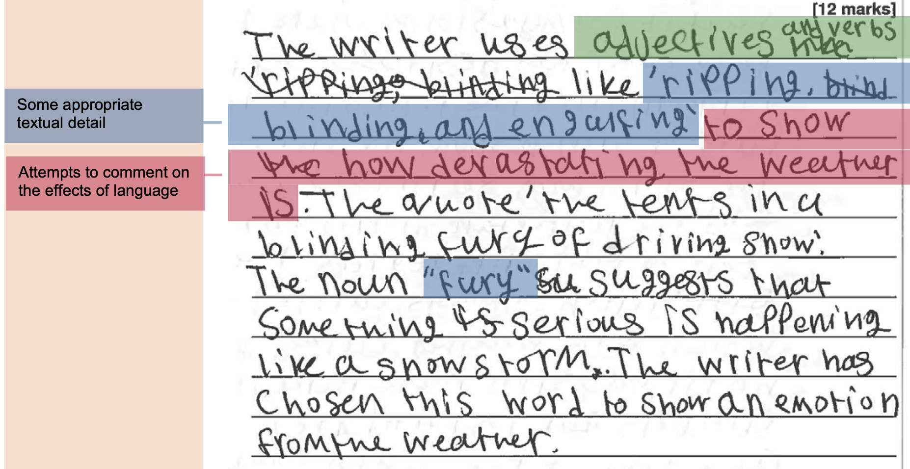
T&T: Why is this better?

Slide 21
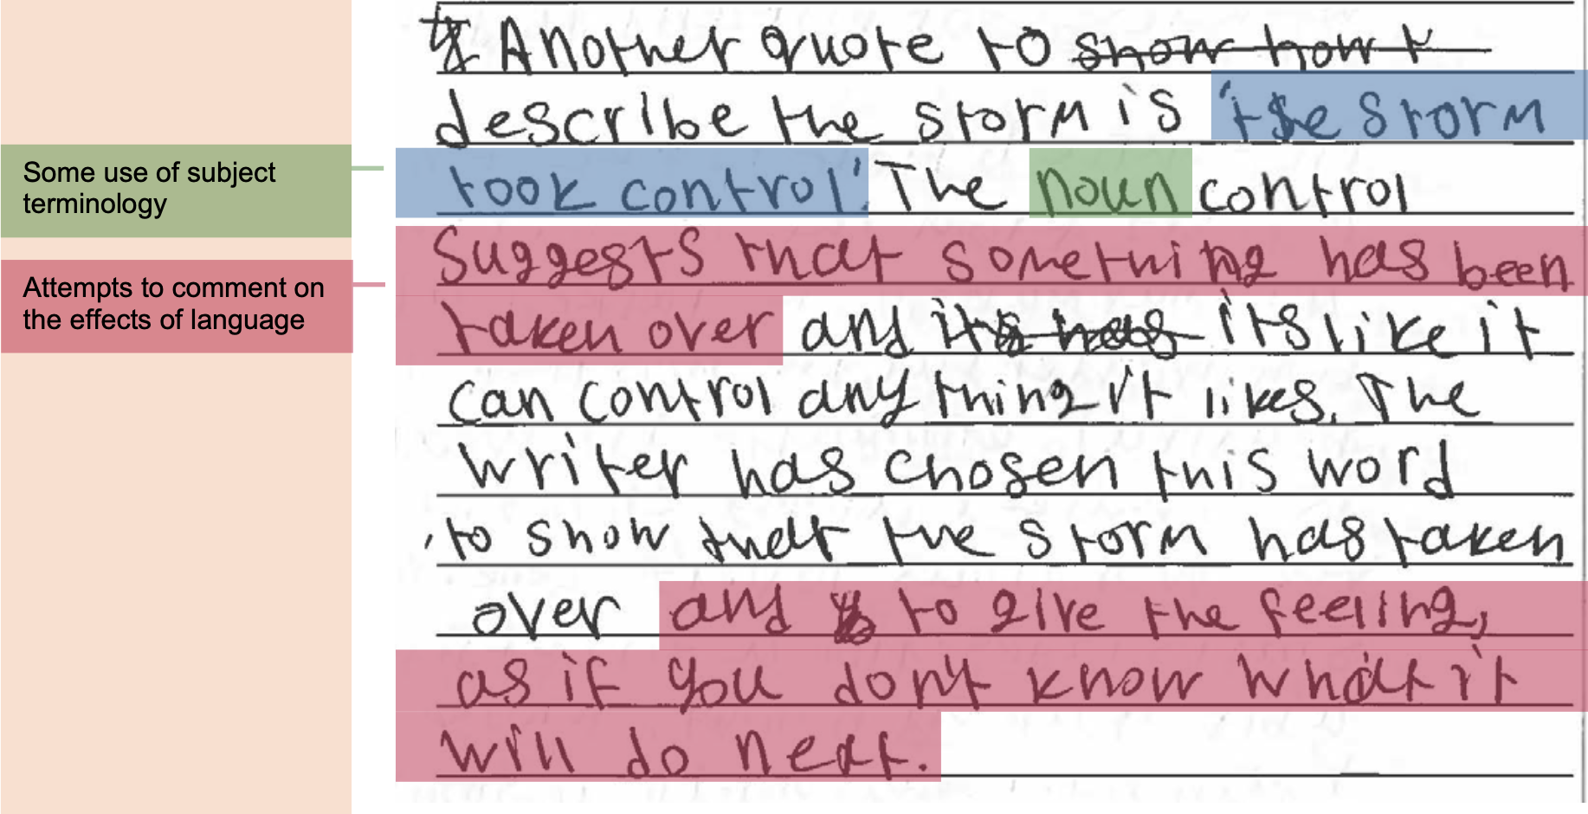
T&T: Why is this better?

Slide 22
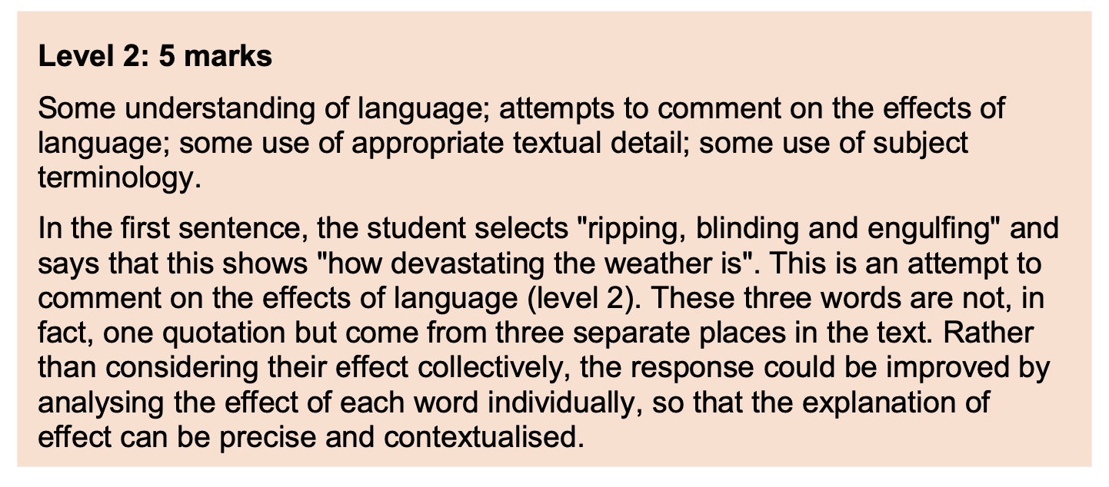
T&T: Why is this better?

Slide 23
Your turn - write a better response

Slide 24
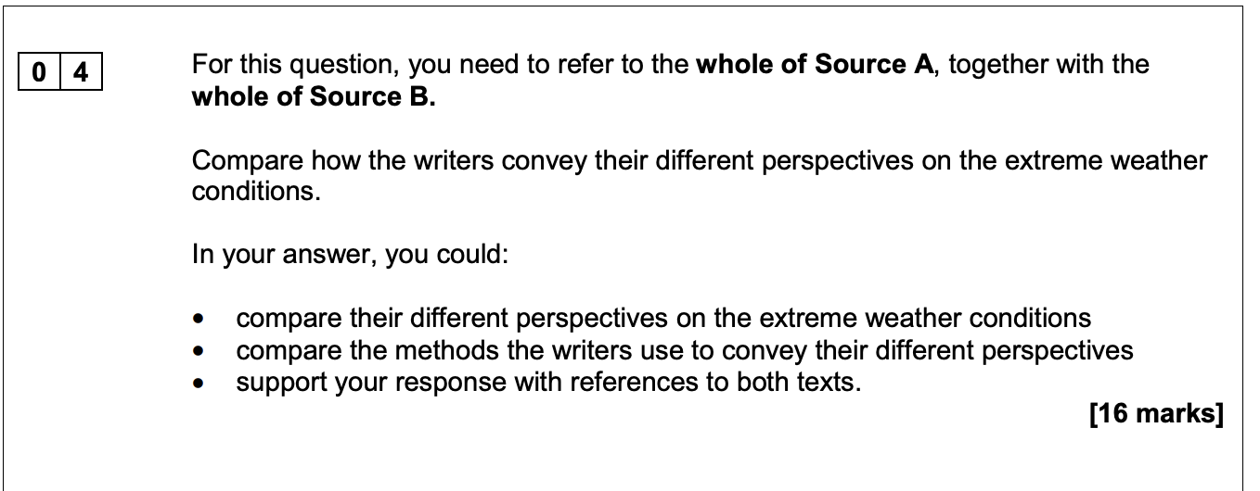
Question 4: initial ideas
Difference - Viewpoint - Quotation - Analysis

Slide 25
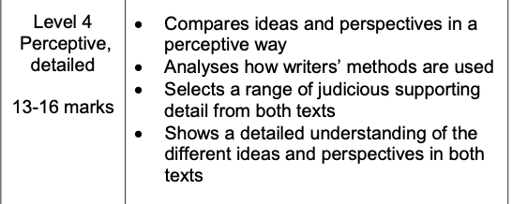
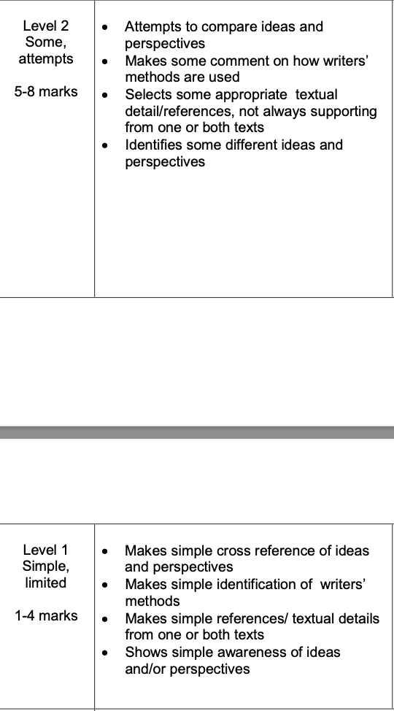
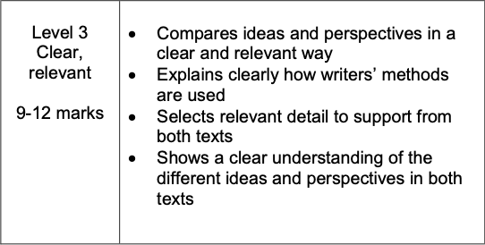
Question 4 mark scheme

Slide 26
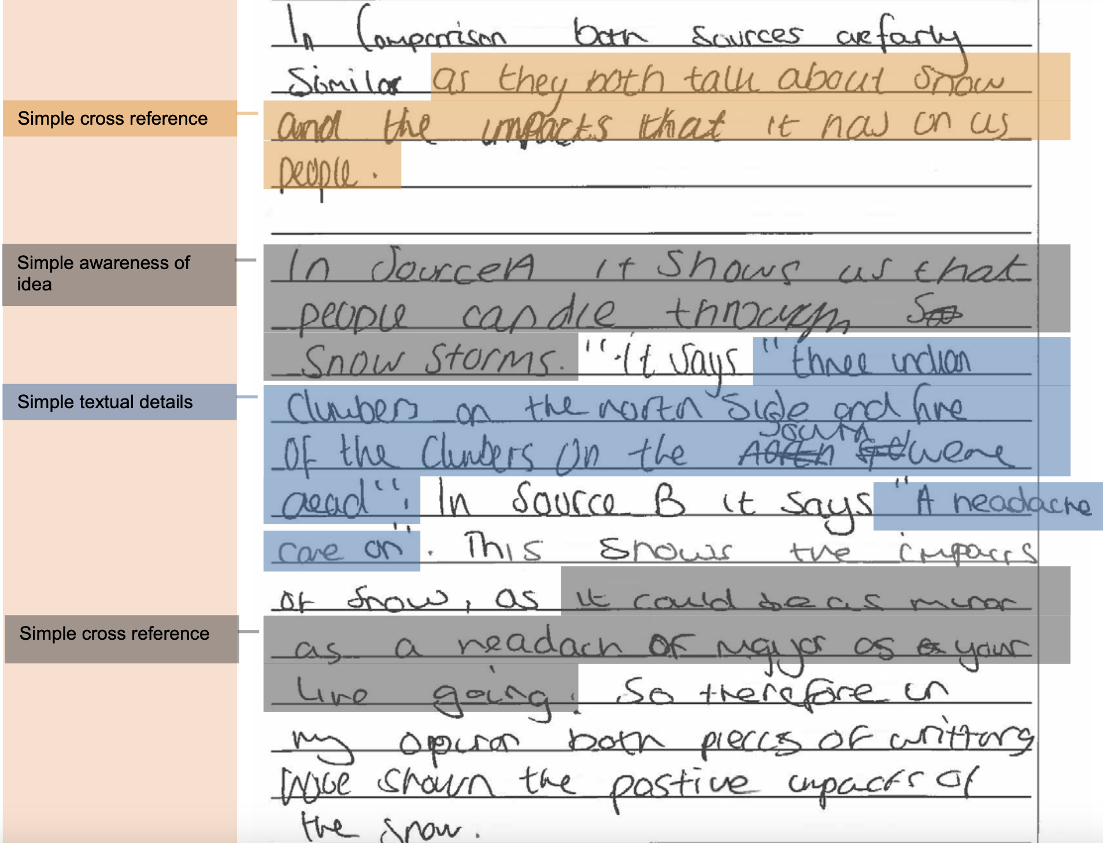
T&T: What mark might this be?

Slide 27
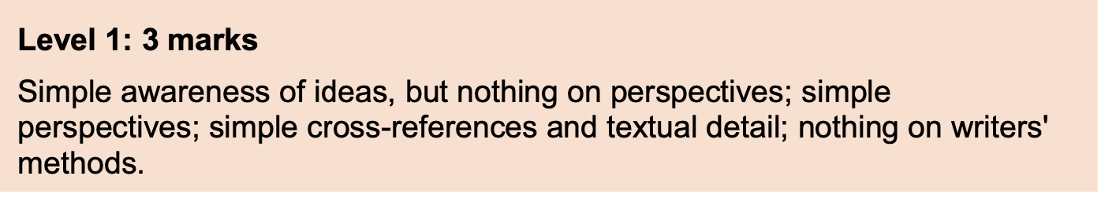
T&T: What mark might this be?

Slide 28
Q4 mark scheme
Level | Skill Descriptors
Level 4 Detailed, perceptive 13-16 marks | ·Shows a detailed understanding of the differences between the ideas and perspectives ·Compares ideas and perspectives in a perceptive way ·Analyses how methods are used to convey ideas and perspectives ·Selects range of judicious quotations from both texts
Level 3 Clear, relevant 9-12 marks | ·Shows a clear understanding of differences between the ideas and perspectives ·Compares ideas and perspectives in a clear and relevant way ·Explains clearly how methods are used to convey ideas and perspectives ·Selects relevant quotations to support from both texts
Level 2 Some, attempts 5-8 marks | ·Identifies some differences between the ideas and perspectives ·Attempts to compare ideas and perspectives ·Some comment on how methods are used to convey ideas and perspectives ·Selects some quotations/references, not always supporting (from one or both texts)
Level 1 Simple, limited 1-4 marks | ·Simple awareness of different ideas and/or perspectives ·Simple cross reference of ideas and/or perspectives ·Simple identification of how differences are conveyed ·Simple references or textual details from one or both texts
Level 0 No marks | No ideas offered about differences Nothing to reward

Slide 29
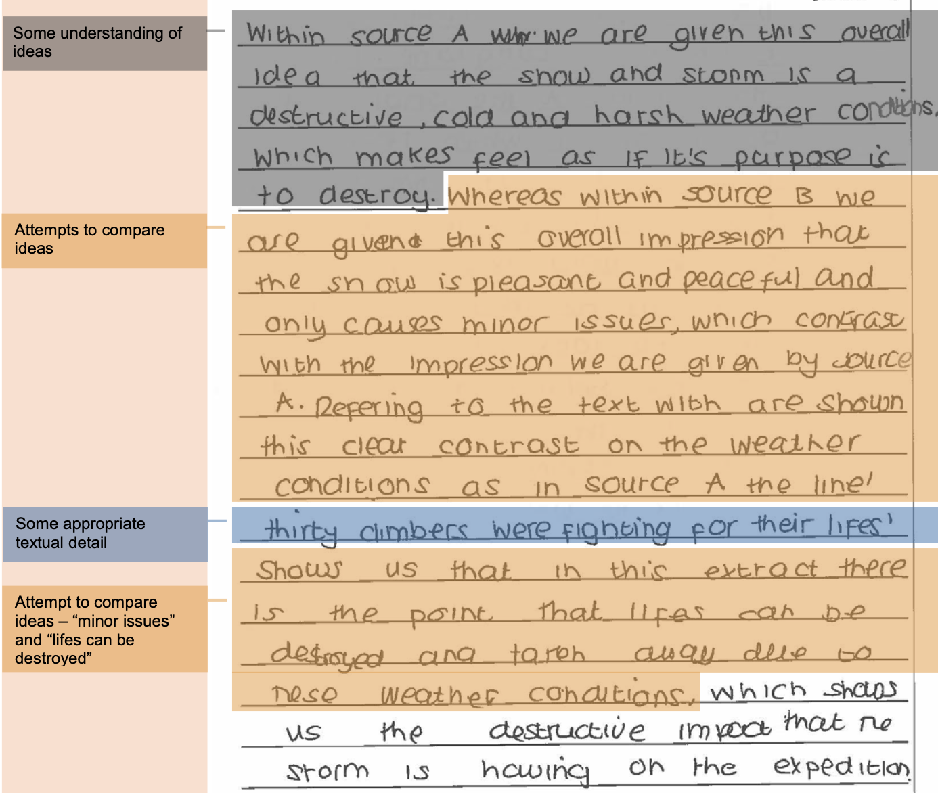
T&T: Why is this better?

Slide 30
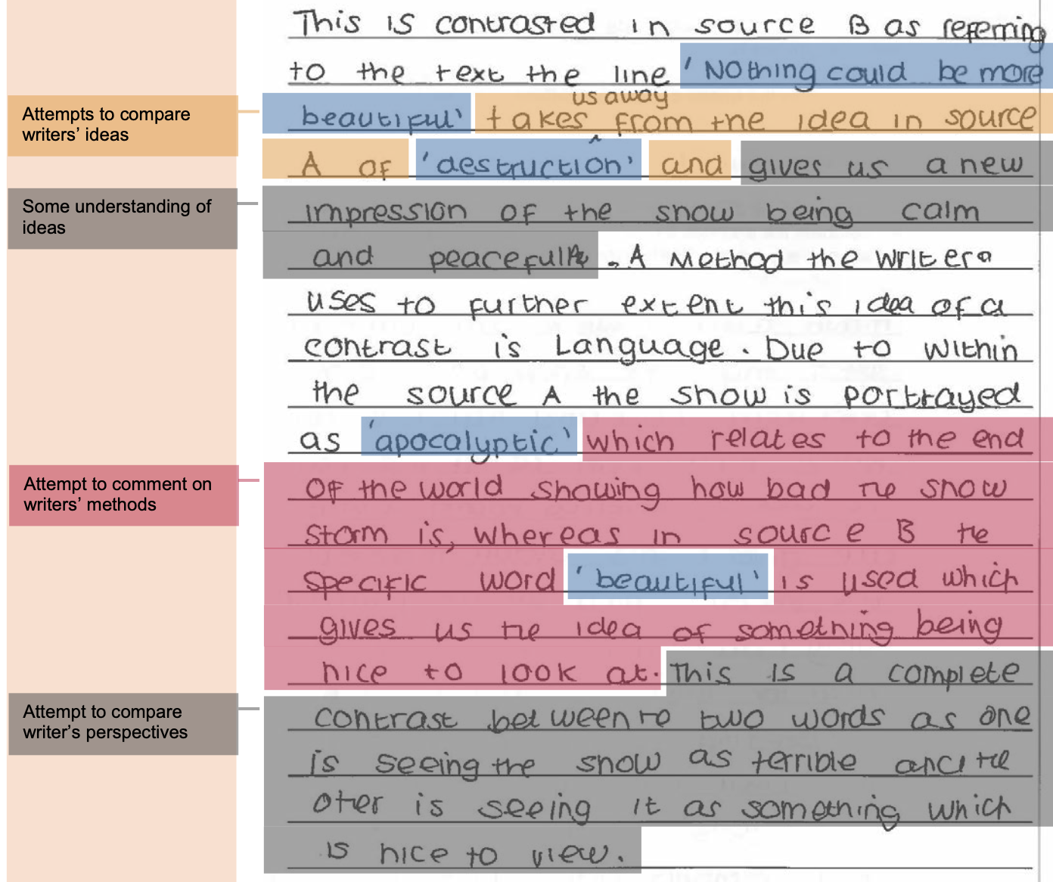
T&T: Why is this better?

Slide 31
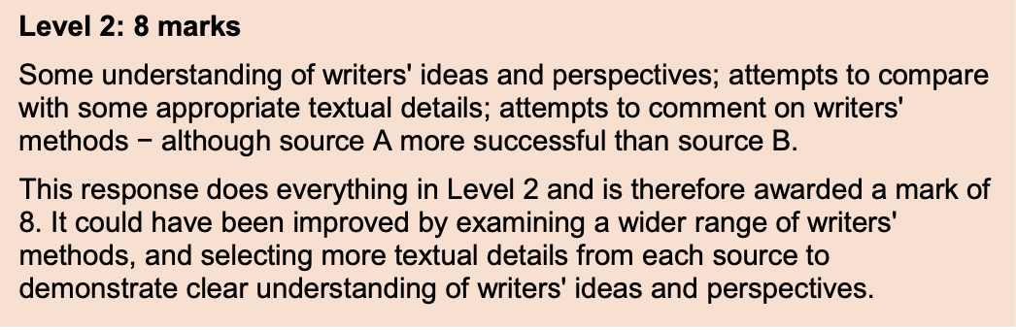
Mark explained

Slide 32
Your turn… write a better response
Level | Skill Descriptors
Level 4 Detailed, perceptive 13-16 marks | ·Shows a detailed understanding of the differences between the ideas and perspectives ·Compares ideas and perspectives in a perceptive way ·Analyses how methods are used to convey ideas and perspectives ·Selects range of judicious quotations from both texts
Level 3 Clear, relevant 9-12 marks | ·Shows a clear understanding of differences between the ideas and perspectives ·Compares ideas and perspectives in a clear and relevant way ·Explains clearly how methods are used to convey ideas and perspectives ·Selects relevant quotations to support from both texts
Level 2 Some, attempts 5-8 marks | ·Identifies some differences between the ideas and perspectives ·Attempts to compare ideas and perspectives ·Some comment on how methods are used to convey ideas and perspectives ·Selects some quotations/references, not always supporting (from one or both texts)
Level 1 Simple, limited 1-4 marks | ·Simple awareness of different ideas and/or perspectives ·Simple cross reference of ideas and/or perspectives ·Simple identification of how differences are conveyed ·Simple references or textual details from one or both texts
Level 0 No marks | No ideas offered about differences Nothing to reward

Slide 33
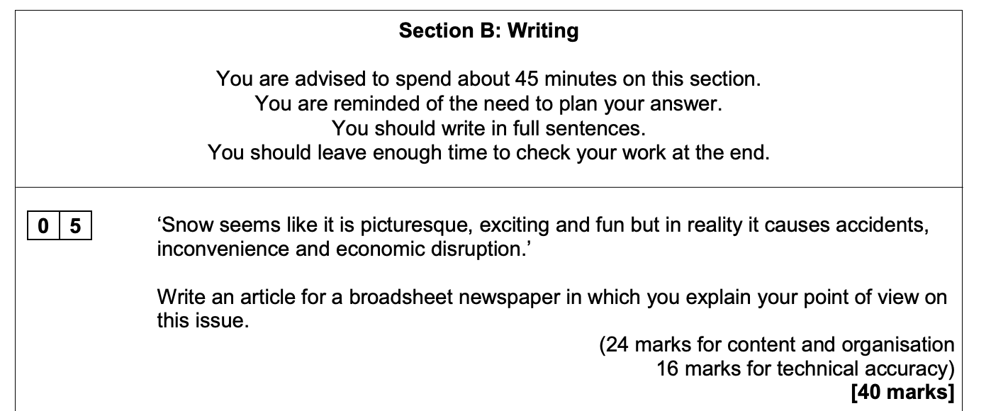
Question 5: initial ideas
Anecdote - Research - Counter - Link

Slide 34
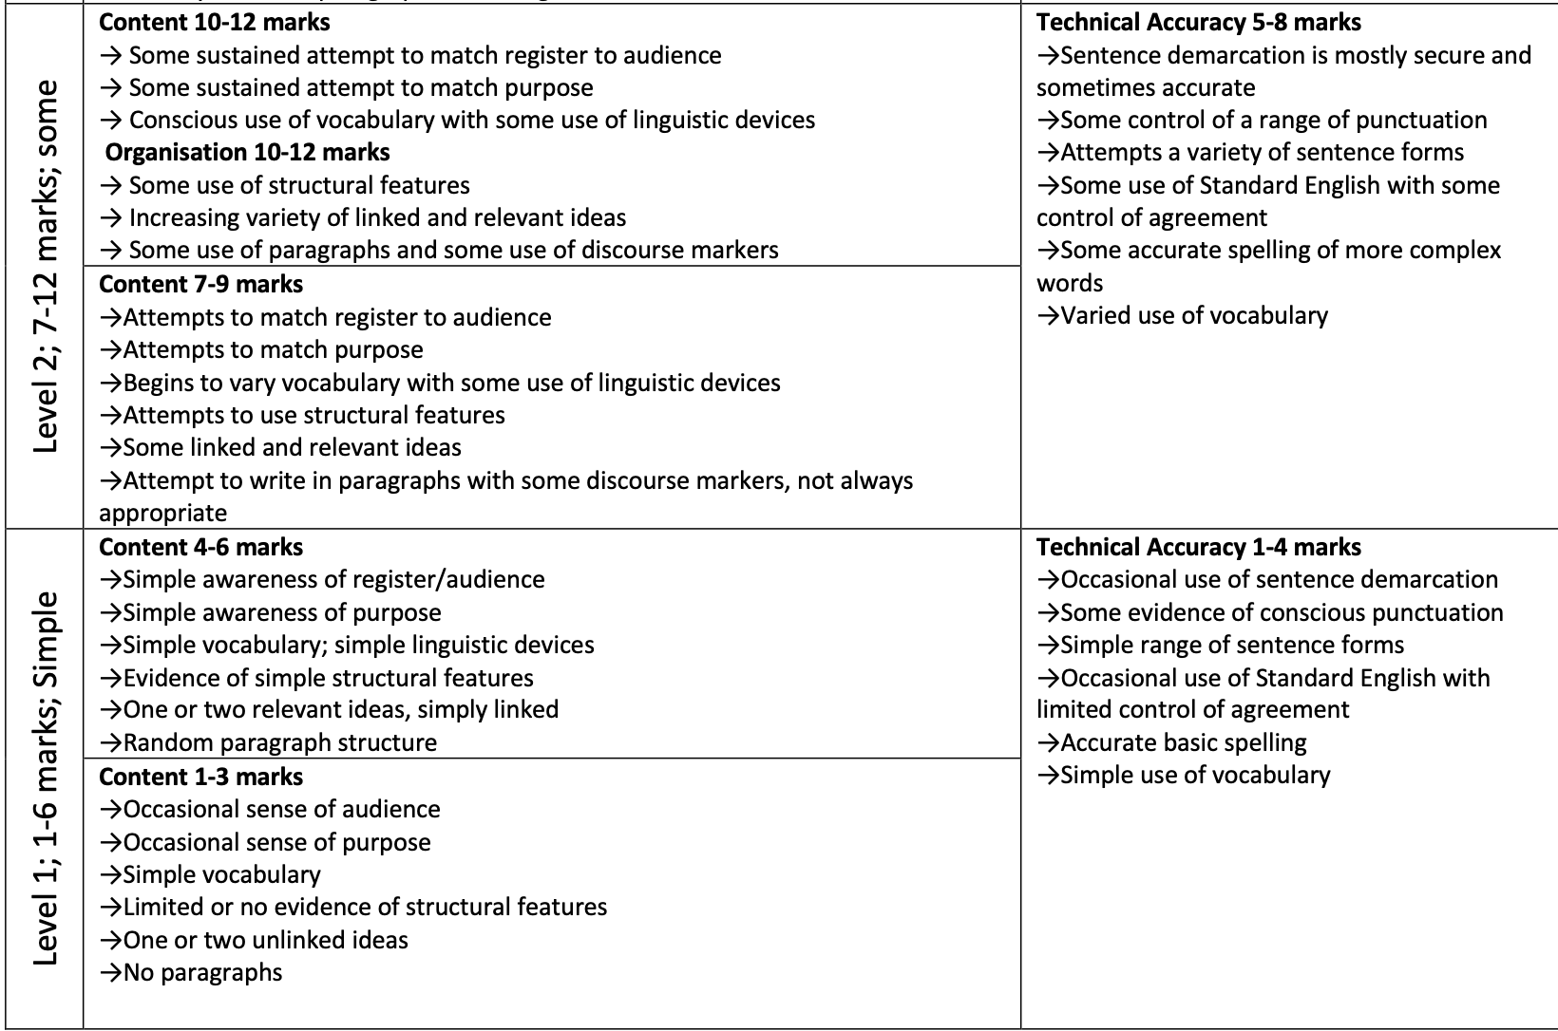
Question 5: mark scheme

Slide 35
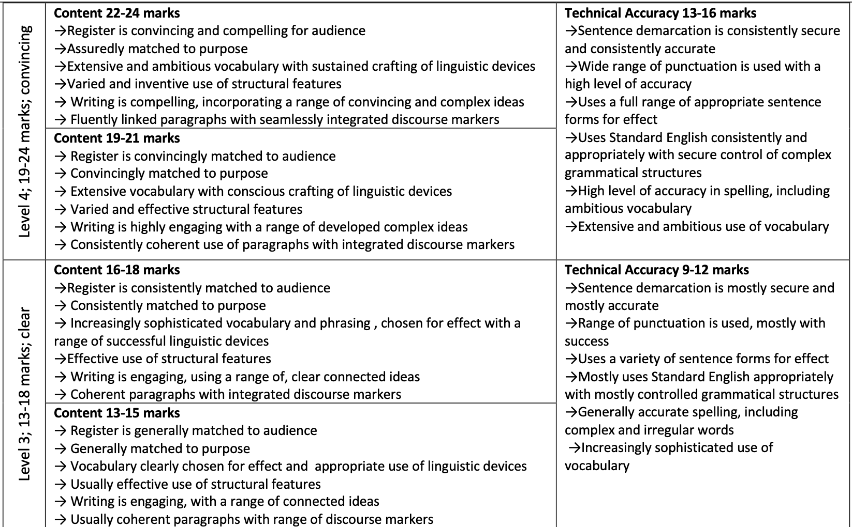
Question 5: mark scheme

Slide 36
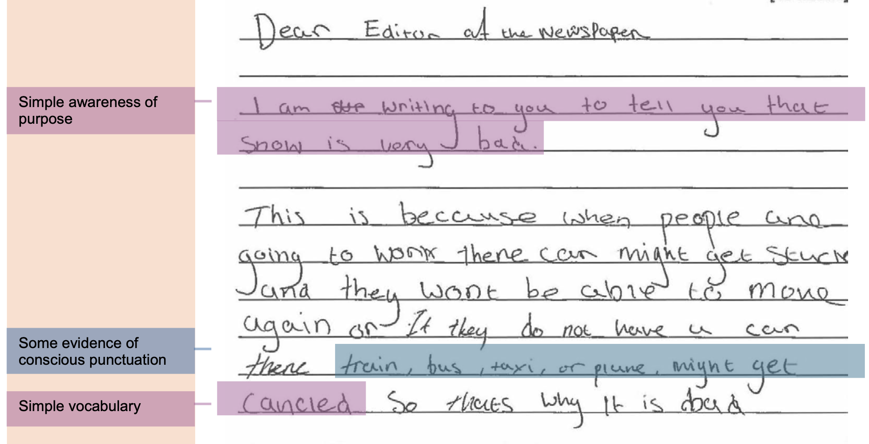
T&T: how would you improve this?

Slide 37
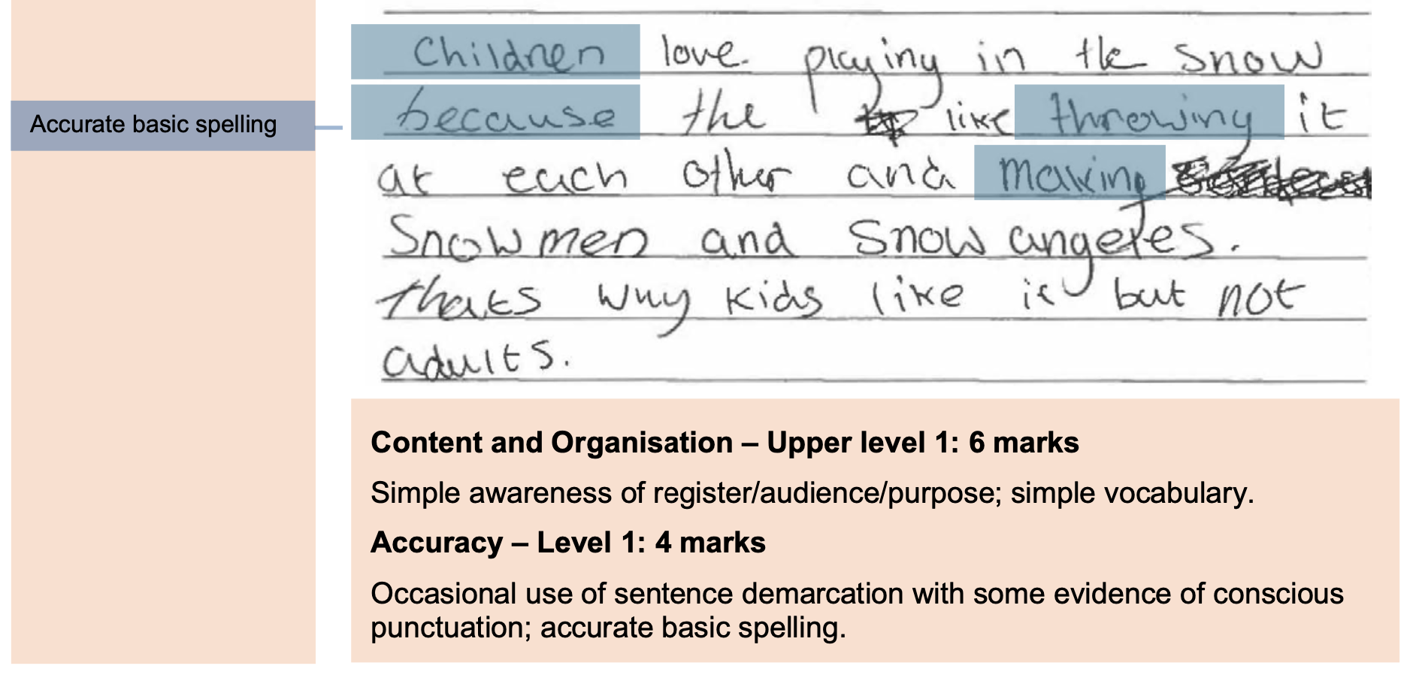
T&T: how would you improve this?

Slide 38
Question 5: mark scheme

Slide 39
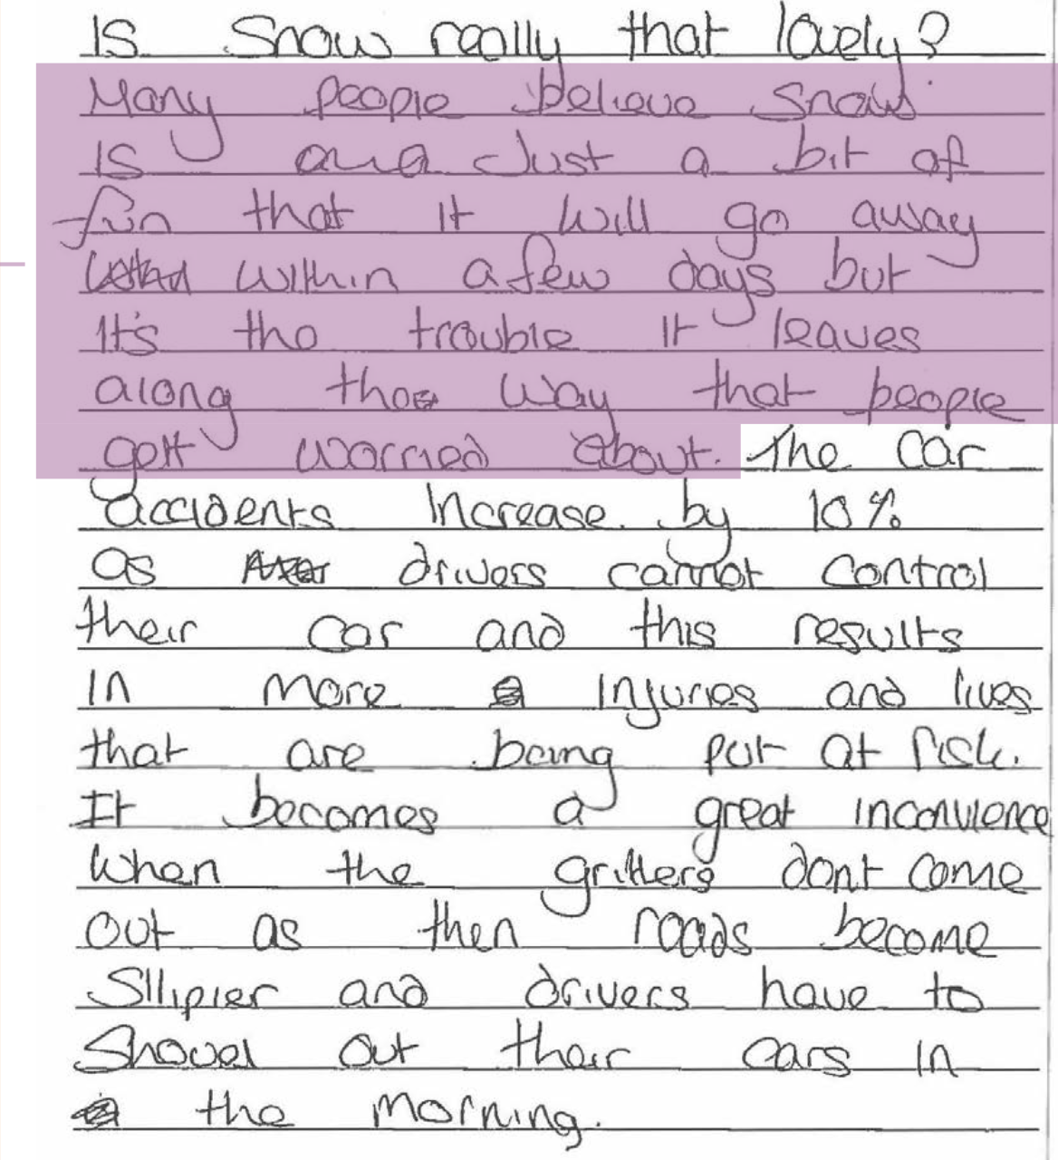
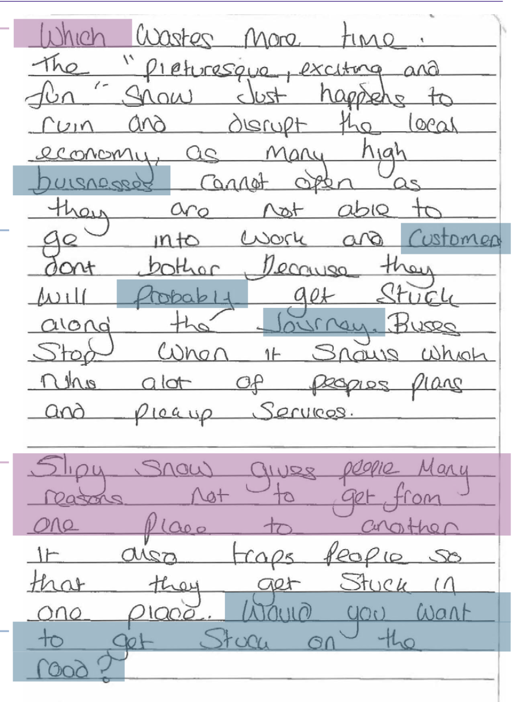
T&T: why is this better?

Slide 40
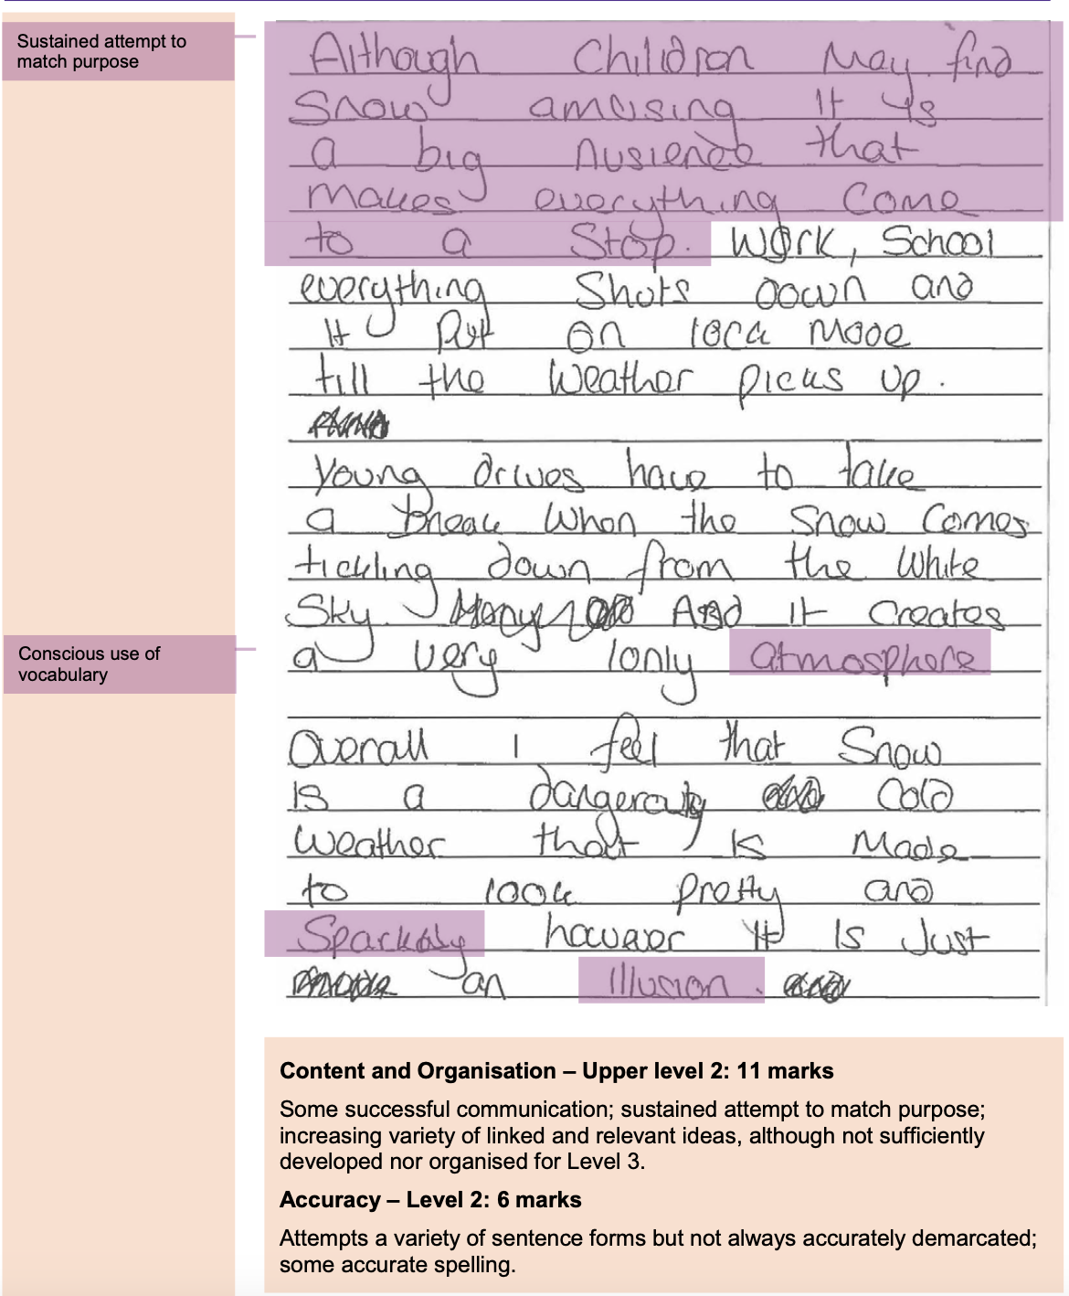
T&T: why is this better?

Slide 41
Your turn: write a better opening

